Slide 1


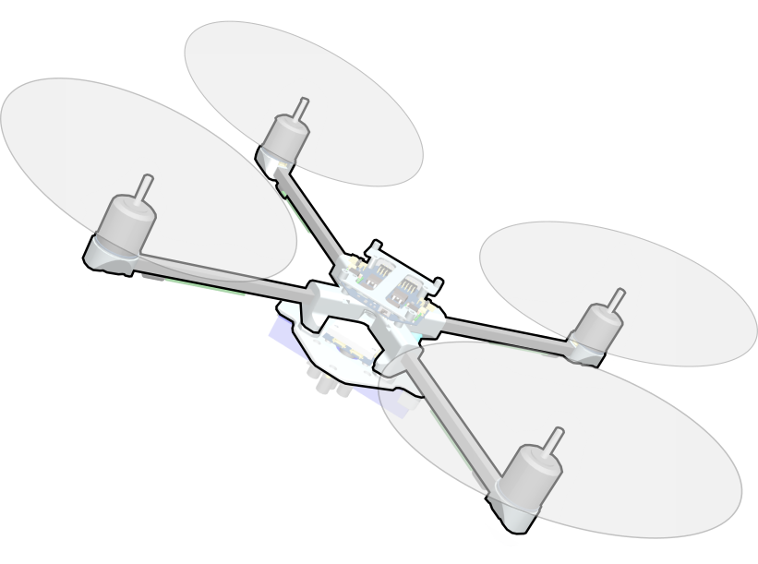
Nonlinear Control for Slung-Load Throwing using Quadrotors
Philipp Föhn, Davide Falanga, Naveen Kuppuswamy, Russ Tedrake, Davide Scaramuzza
Robotics and Perception Group
Department of Informatics, University of Zurich
Notes:
Hello thanks for having me.
Name, with Davide Scaramuzza’s RPG and I’ll present my work on TITLE
quadrotors astonishing vehicles, extremely agile, yet simple.
Nowadays, frequently observation tasks in many environments, not transportation & manipulation.
might be because inefficient, they have to adjust attitude to change acceleration and
They have 4 dangerously spinning rotors around them
This makes it difficult to attach grippers or robotic arms to them.
But there are other methods

Slide 2
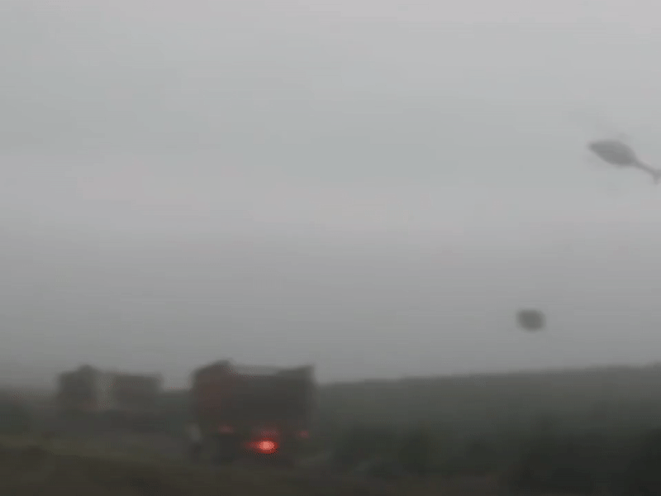
[Video by “TheNorthwestReport”: https://youtu.be/08K_aEajzNA]
Notes:
Look at this beautiful slung-load maneuver by a very skilled copter pilot.
A quadrotor with such capabilities could be used in many transportation szenarios

Slide 3

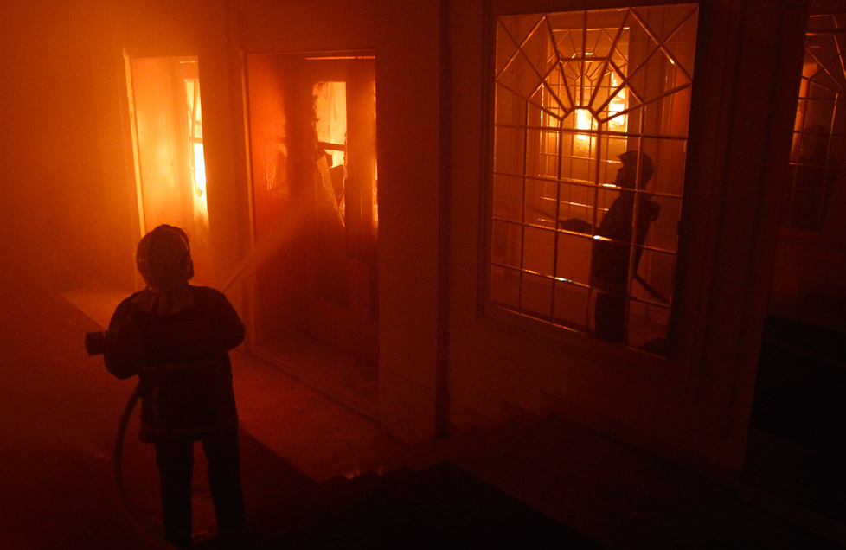
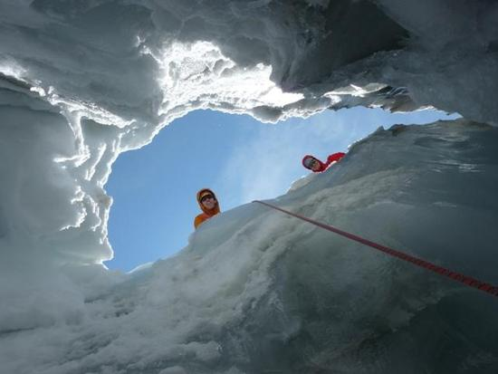
Motivation
A slung-load is:
Lightweight
Simple
Attitude decoupled
Efficient
Distant
Notes:
Adding a slung-load to a quadrotor has some advantages over gripers or arms.
It is extremely lightweight, due to the mechanical simplicity.
Together with the fact that the quadrotor attitude is decoupled from the load, it makes the vehicle a great
deal more efficient.
And it puts some distance between the rotors and the quadrotor

Slide 4
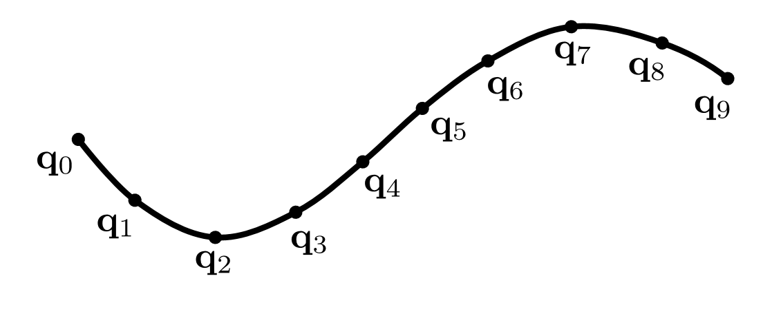

Challenges
System Dynamics:
  Cable can be taut or slack
  Hybrid modes? Transitions?
Under-actuated system:
  Trajectory planning by optimization
Task description by constraints:
  Waypoint navigation
  Obstacle avoidance
  Load Throwing
Notes:
To get there, we had to face some challenges:
First of all, the cable between the quadrotor and the load can be taut or slack, which totally changes the dynamics of the system.
One could cover this with multiple system models, so called hybrid modes, which were used in some related work by the groups of Vijay Kumar and Jonas Buchli.
But then one has to handle transitions, mode sequences and other difficulties, so we try to find a better way.
Furthermore, the quadrotor and slung load are an under-actuated system, so we can not directly control towards a state,
But we have to plan a trajectory using optimization.
For this we need a mathematically sound and meaningful way of describing the Task.
We do this by including them as constraints, for example the target to throw the load to.
This way we leave all parameters like release position open to the optimization.

Slide 5
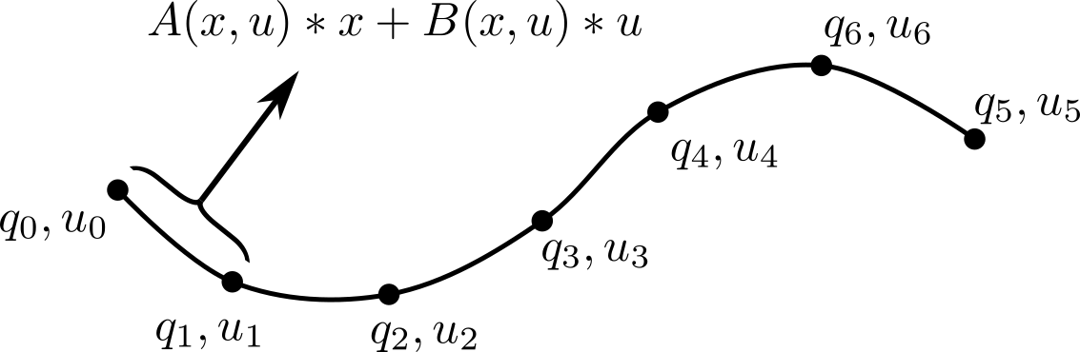

Planning as an optimization problem
Trajectory: Sequence of states and inputs in time
Optimization:
  minimize quadratic cost $L\left(q,\dot{q},u,t\right)$
  subject to system dynamics $H\left(q\right)\ddot{q}+C\left(q,\dot{q}\right)+G\left(q\right)=B\left(q\right)u+J{\left(q\right)}^{T}λ$
  and constraints $f\left(q,u\right)≥0$
Notes:
To pose the planning as an optimization problem, we first must find a way to describe our trajectory.
We do this as a sequence of states and inputs in time, contrary to other approaches which use polynomials.
With this simple form, constraints can be added very easily and the dynamics are integrated by just constraining two states over an approximation of the dynamics between them, for example the linearization.
The optimization itself then minimizes a quadratic cost on states and inputs and a linear cost on time, subject to the dynamics and the constraints.

Slide 6
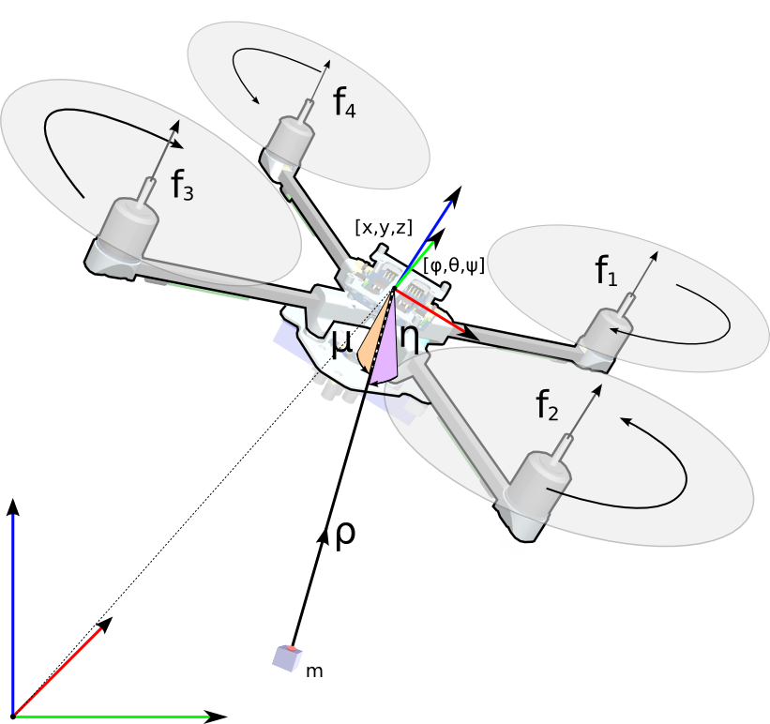
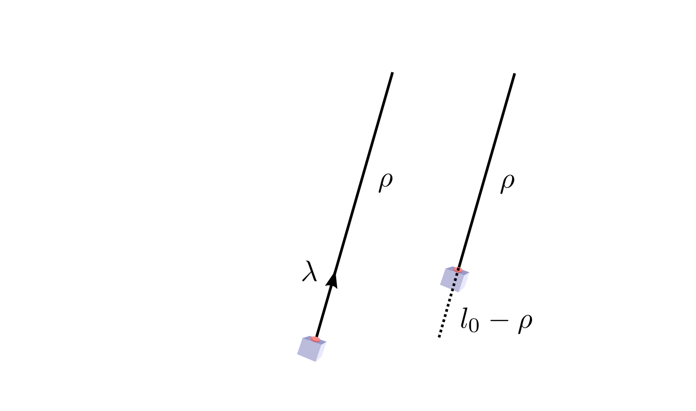
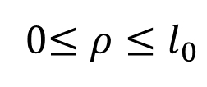



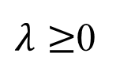
Modelling Approach
taut:
slack:
$$l_{0}−ρ=0$$
$$λ=0$$
0$≤ρ≤l_{0}$
$λ≥$0
$$\left(l_{0}−ρ\right)∗λ=0$$
Notes:
To make this possible, we focus on a novel and clever modelling approach where we don’t have to use hybrid modes.
We described the load with coordinates relative to the quadrotor as two angular and one distance states.
The distance RHO can only be between 0 and L0, the cable’s length.
Additionally, we have a reaction force from the cable, called LAMBDA.
When the string is taut, the difference between maximal length and actual length is zero.
On the other hand, when it is slack, the reaction force LAMBDA must be zero.
We can now use this and enforce a constraint so that the multiplication of both must always be zero.
Then we look in each timestep for the smallest possible lambda that does not violate any of these constraints.

Slide 7
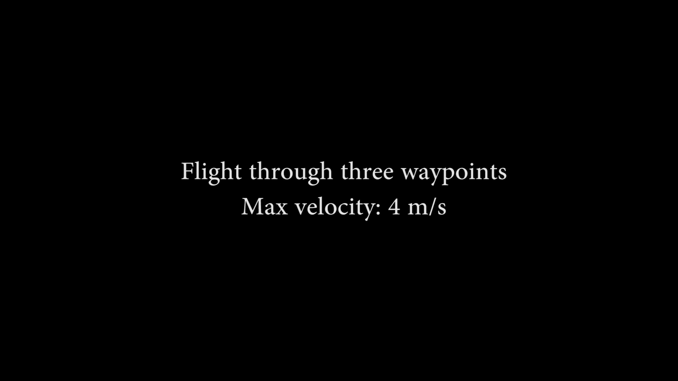
Experiments

