Slide 1
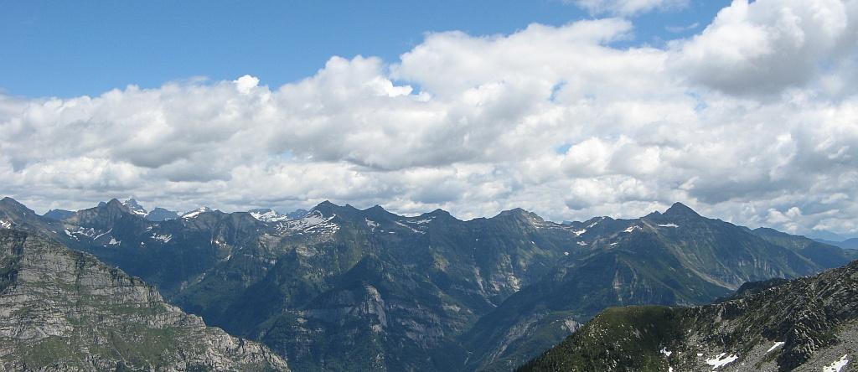
A Machine Learning Approach to the Visual Perception of Forest Trails for Mobile Robots
A. Giusti, J. Guzzi, D. Ciresan, F. Lin He, J. Pablo Rodríguez F. Fontana, M. Faessler, C. Forster J. Schmidhuber, G. Di Caro, D. Scaramuzza, L. Gambardella
IDSIA, USI-SUPSI, Lugano, Switzerland RPG, University of Zurich, Switzerland

Slide 2
Steering a MAV with a purely reactive controller

Slide 3
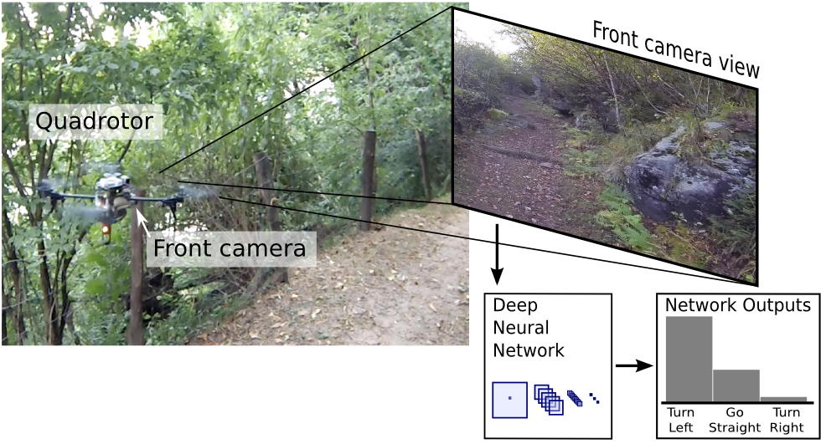
Long-term objective
MAV autonomously follows a forest trail
Applications in search and rescue

Slide 4
Our focus
Perception of the trail direction
Mapping
Obstacle perception and avoidance
Path Planning
Visual Odometry
Control

Slide 5
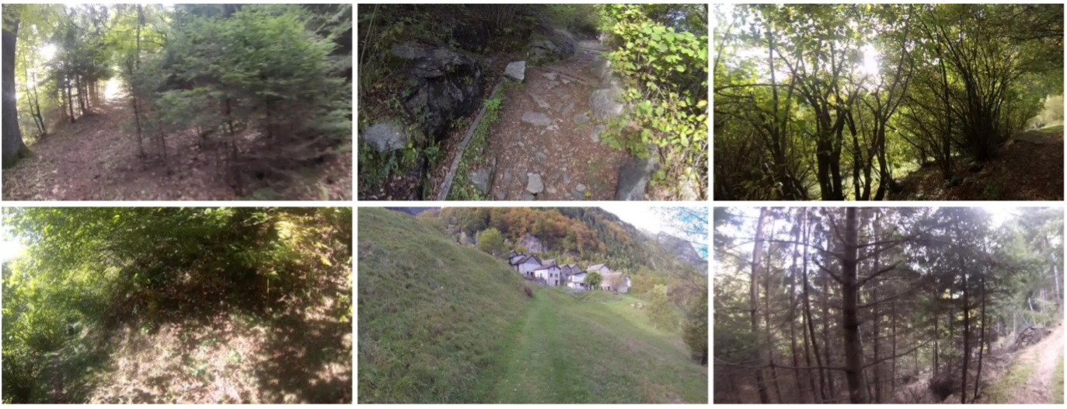
A challenging pattern recognition problem
Trail heading left
Trail heading straight ahead
Trail heading right

Slide 6
Our tool: Deep Neural Networks
Huge, Deep Convolutional Neural Networks with Max-Pooling layers, trained on GPU using backpropagation
Input: raw pixel intensity values
No feature engineering
State-of-the-art performance in many pattern recognition tasks
Digit recognition, traffic sign recognition [1]
Ciresan et al., CVPR 2012
Segmentation of neurons in electron microscopy images [2,3,4]
Ciresan et al., NIPS 2012;
Funke et al., MICCAI 2014
Parag et al., ICCV 2015
Detection of mitotic cells [5]
Giusti et al., MICCAI 2013

Slide 7
An image classification problem
Input
Raw pixel values
P(trail is left)
Deep Neural Network
P(trail is straight)
P(trail is right)

Slide 8
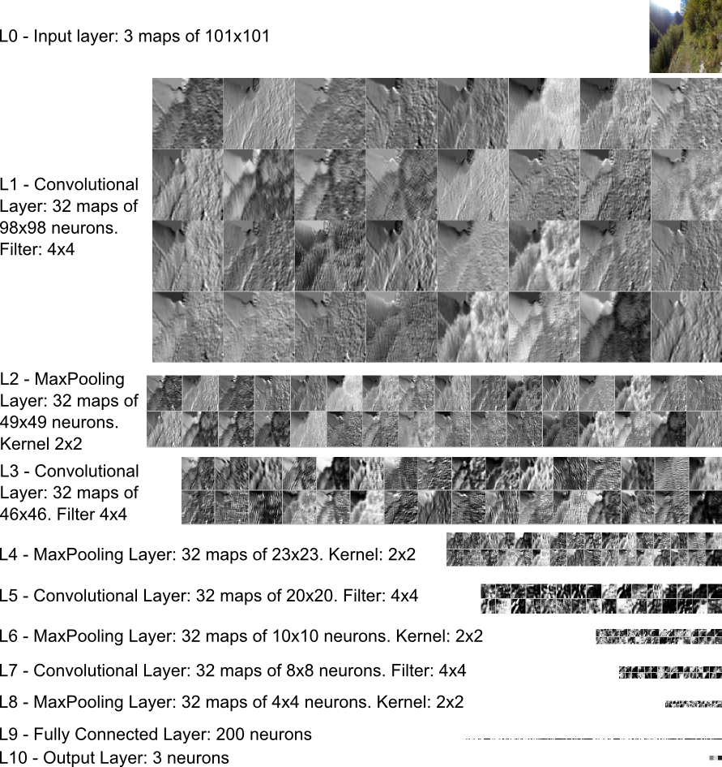
Deep Network Architecture

Slide 9
Internal view of the classifier

Slide 10
How the classifier was trained

Slide 11
Dataset size

Slide 12
Classification accuracy
Our classifier (accuracy: 85%)
Human observer (accuracy: 86%)

Slide 13
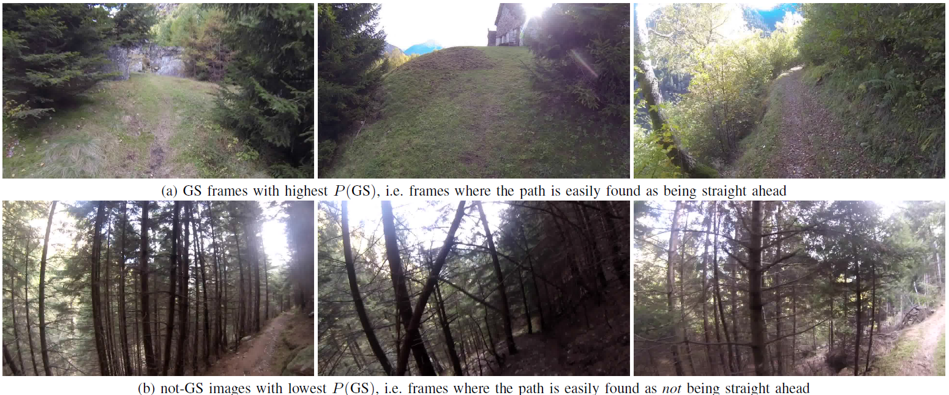
Test images which are easily classified

Slide 14
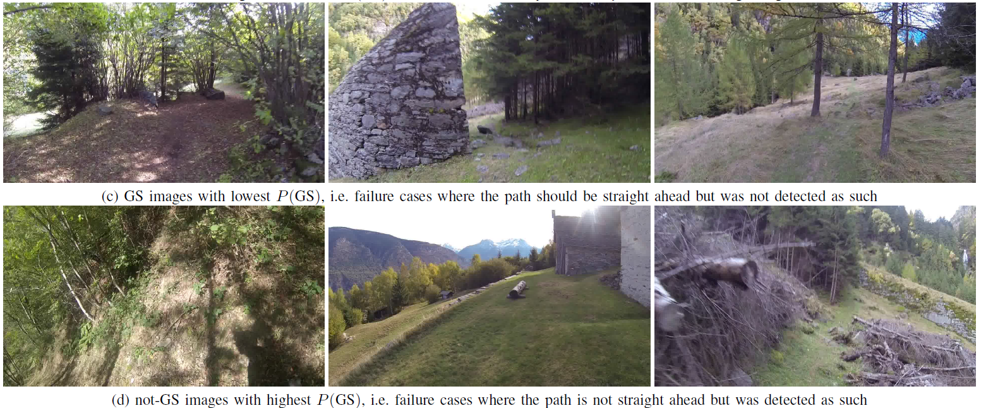
Test images which are misclassified

Slide 15
Application to video acquired from an handheld camera

Slide 16
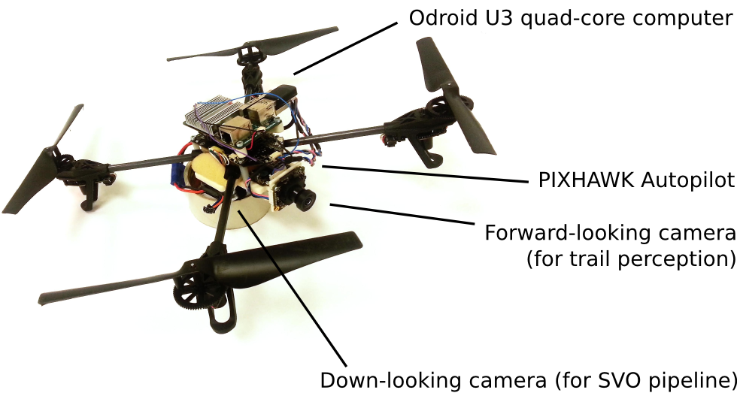
Conclusions
Pure machine learning approach to trail perception
Performance comparable to humans when tested on individual frames of the test set
Onboard odroid U3 runs SVO pipeline and DNN at more than 15FPS

