Slide 1


Titus Cieslewski, Elia Kaufmann, Davide Scaramuzza
Institute of Informatics – Institute of Neuroinformatics
Rapid Exploration with Multi-Rotors:
A Frontier Selection Method for High Speed Flight
T. Cieslewski, E. Kaufmann, D. Scaramuzza: Rapid Exploration with Multi-Rotors: A Frontier Selection Method … IROS 2017
Notes:
Focus on an ability of the system to persistently deliver its services in a dependable way even when facing changes, unforeseen failures and intrusions.

Slide 2
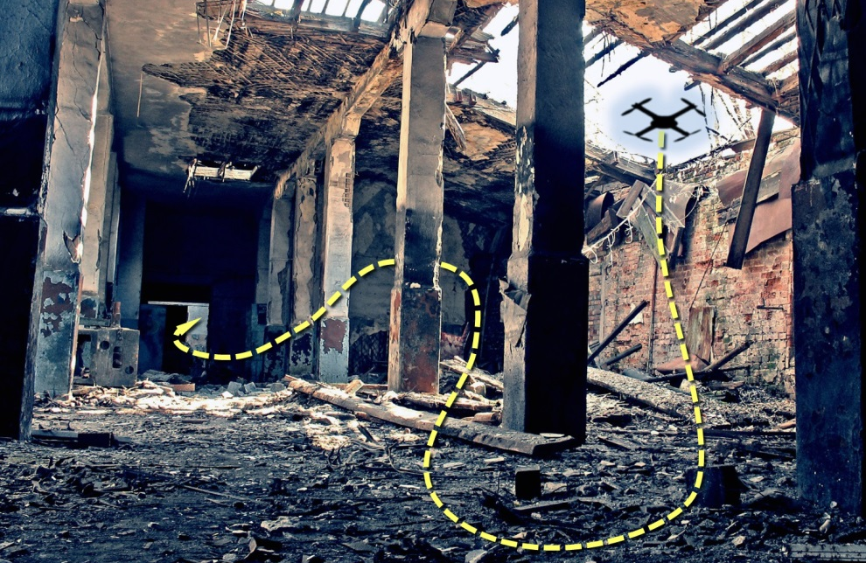
Exploration with Multi-Rotors
Exploration use cases
  Create a map of an unknown area
  Find objects / people (e.g. earthquake survivors)
A case for multi-rotors
  Can handle any terrain
  Can be very fast
T. Cieslewski, E. Kaufmann, D. Scaramuzza: Rapid Exploration with Multi-Rotors: A Frontier Selection Method … IROS 2017

Slide 3
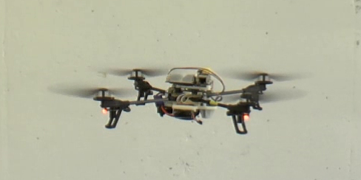
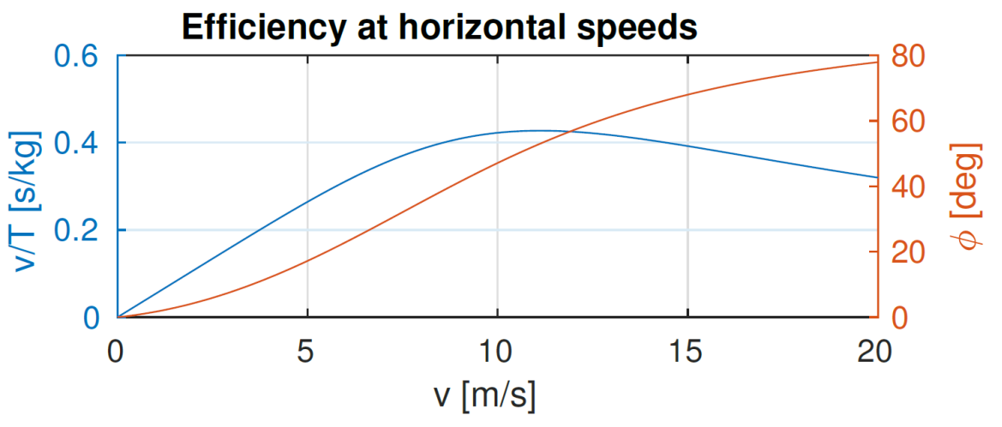
Multi-Rotors: Best used at high speeds
High speed is not just a feature
  but also required for optimal use
Hovering = energy spent, not much achieved
Efficiency: Distance covered per energy used (thrust)
  Too slow: Waste on hovering
  Too fast: Aerodynamic drag
Ballpark optimum: 10 m/s
  Model from [Omari 2013]
T. Cieslewski, E. Kaufmann, D. Scaramuzza: Rapid Exploration with Multi-Rotors: A Frontier Selection Method … IROS 2017

Slide 4
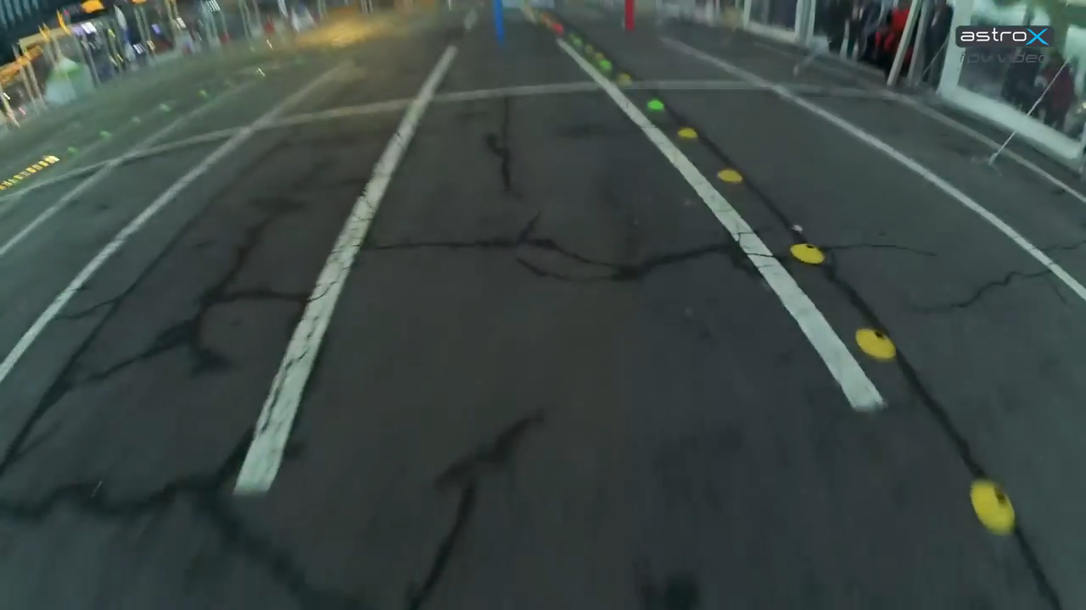
What does this mean for exploration?
Speed ~ momentum:
  Don’t change direction too much
Need to react to new information quickly
Can we fly at 10 m/s yet?
  No?
  Perception limitations
  See IROS autonomous drone racing!
  Assuming given max speed
Drone Show Korea 2016, YouTube
T. Cieslewski, E. Kaufmann, D. Scaramuzza: Rapid Exploration with Multi-Rotors: A Frontier Selection Method … IROS 2017

Slide 5
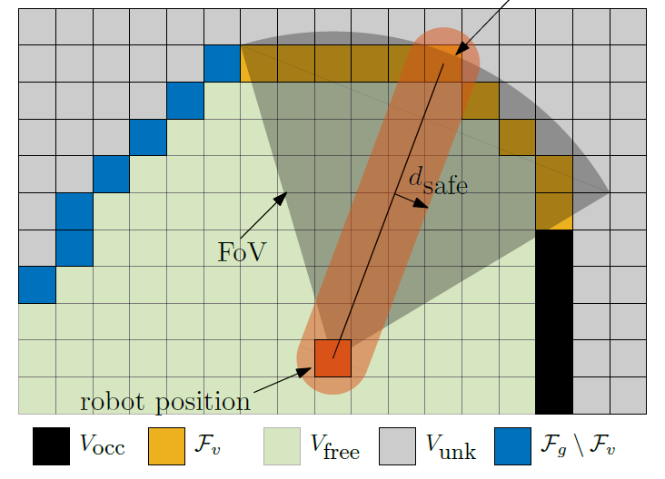
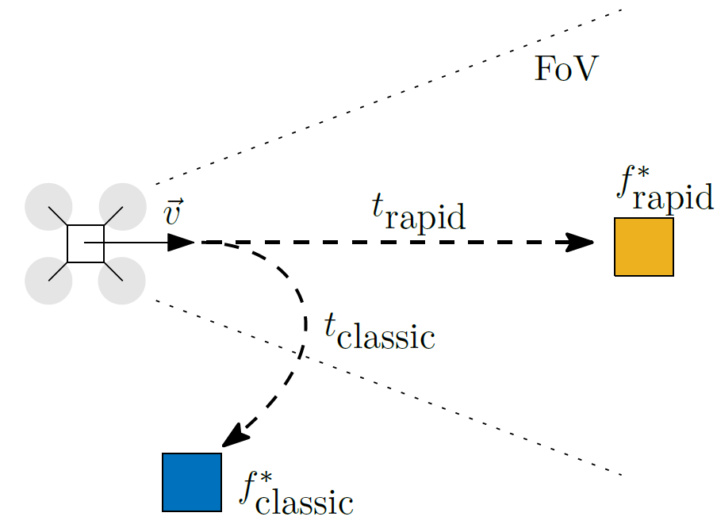
Our approach
Frontier-based exploration
  Occupancy grid: Free, occupied or unknown voxels
  Navigate to free next to unknown (“frontier”)
Select frontier minimizing velocity change
Incidentally, this is often in the field of view: Rapid retrieval
Else, fall back to classical Frontier-Based Exploration
T. Cieslewski, E. Kaufmann, D. Scaramuzza: Rapid Exploration with Multi-Rotors: A Frontier Selection Method … IROS 2017

Slide 6
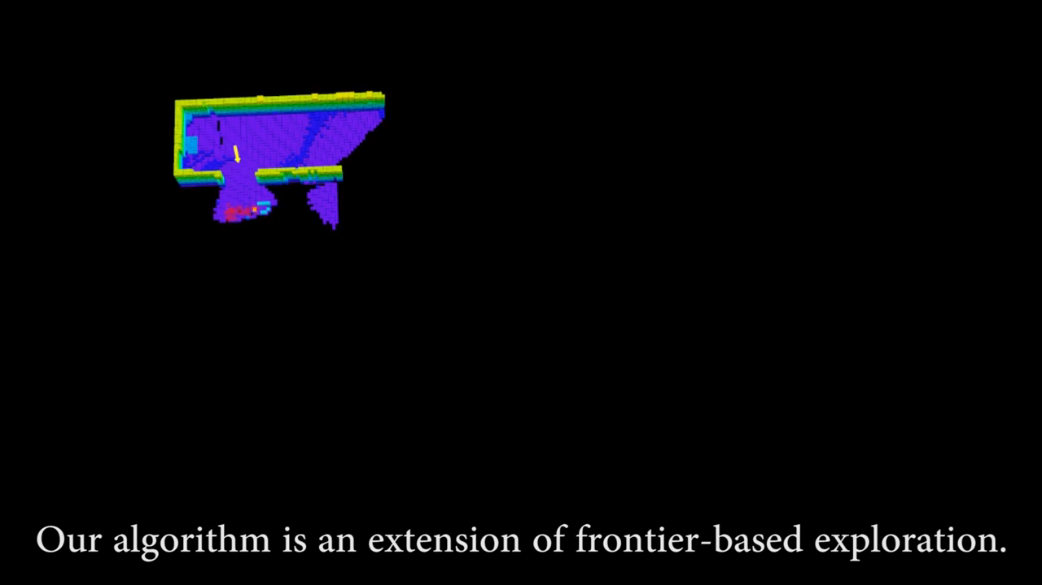
Our approach
T. Cieslewski, E. Kaufmann, D. Scaramuzza: Rapid Exploration with Multi-Rotors: A Frontier Selection Method … IROS 2017

Slide 7
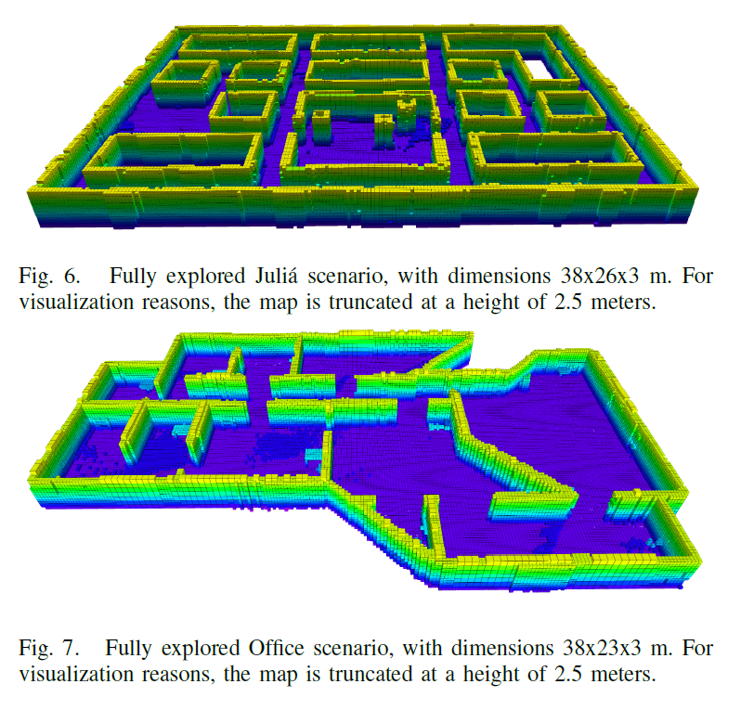
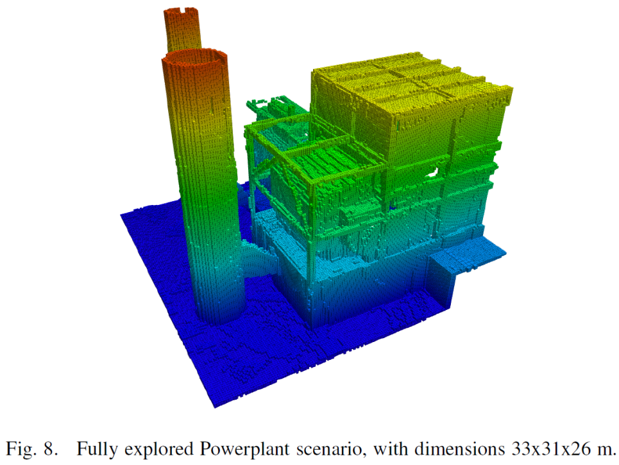
Comparison to other approaches
Classical Frontier-Based Exploration [Juliá 2012]
Next-best view exploration [Bircher 2016]
T. Cieslewski, E. Kaufmann, D. Scaramuzza: Rapid Exploration with Multi-Rotors: A Frontier Selection Method … IROS 2017

Slide 8
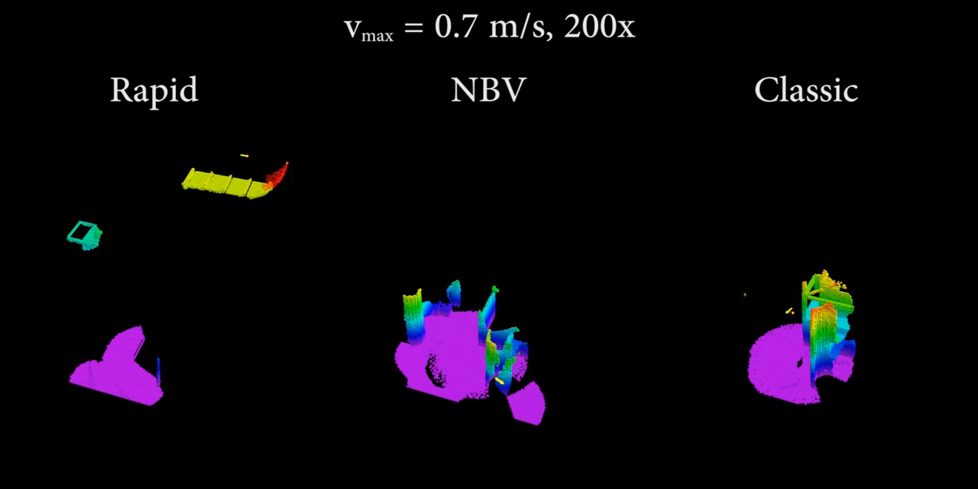
Comparison to other approaches
T. Cieslewski, E. Kaufmann, D. Scaramuzza: Rapid Exploration with Multi-Rotors: A Frontier Selection Method … IROS 2017

Slide 9
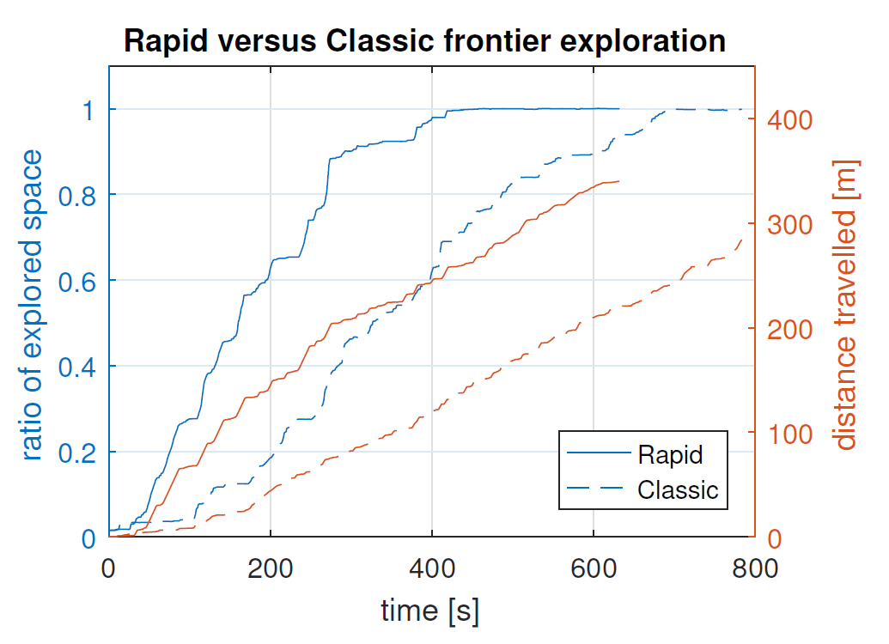
Results
T. Cieslewski, E. Kaufmann, D. Scaramuzza: Rapid Exploration with Multi-Rotors: A Frontier Selection Method … IROS 2017

Slide 10
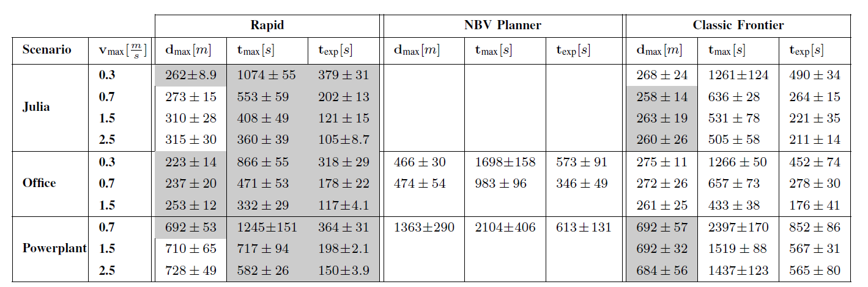
Results
T. Cieslewski, E. Kaufmann, D. Scaramuzza: Rapid Exploration with Multi-Rotors: A Frontier Selection Method … IROS 2017

Slide 11
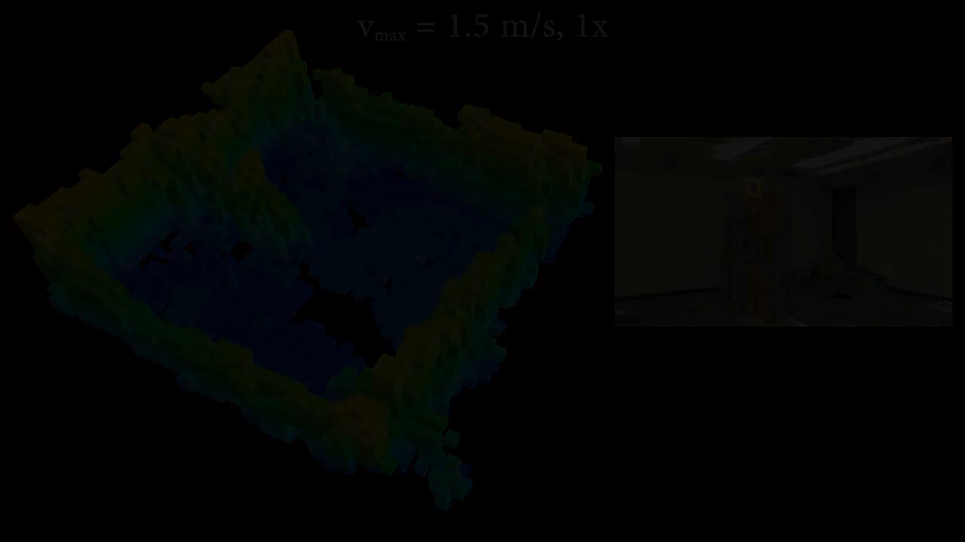
Real world validation: indoors
T. Cieslewski, E. Kaufmann, D. Scaramuzza: Rapid Exploration with Multi-Rotors: A Frontier Selection Method … IROS 2017

Slide 12
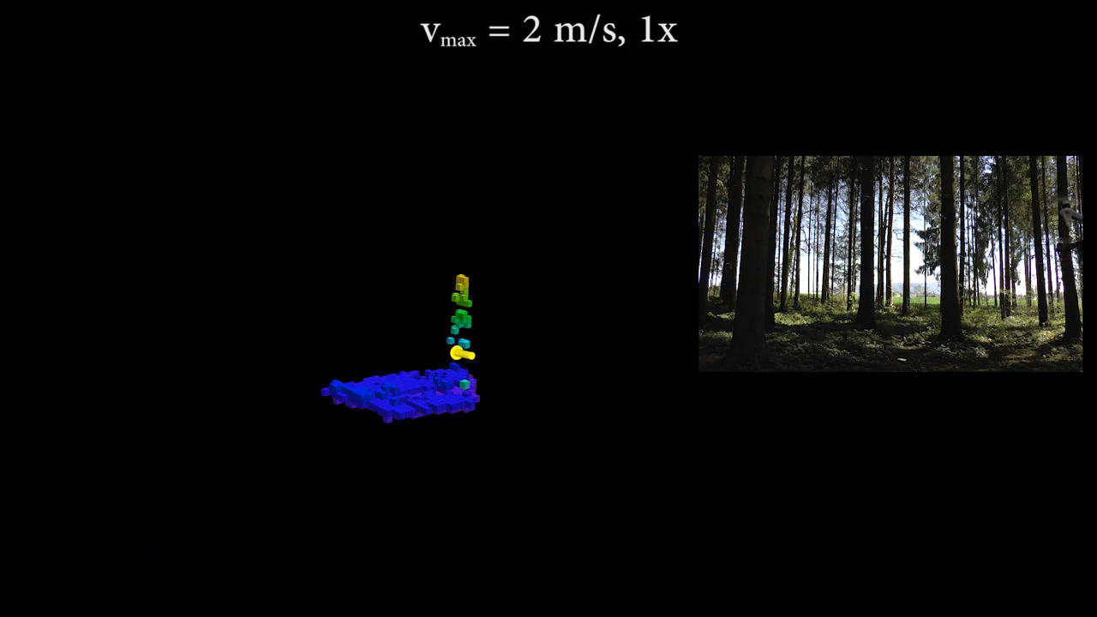
Real world validation: outdoors
T. Cieslewski, E. Kaufmann, D. Scaramuzza: Rapid Exploration with Multi-Rotors: A Frontier Selection Method … IROS 2017

Slide 13

Conclusion
Proposed an exploration algorithm tailored to high-speed flight
A lot can be achieved with simple means
Distance does not matter as much as flight time
T. Cieslewski, E. Kaufmann, D. Scaramuzza: Rapid Exploration with Multi-Rotors: A Frontier Selection Method … IROS 2017

