Slide 1
Perception-aware Receding Horizon Navigation for MAVs
Zichao Zhang, Davide Scaramuzza
rpg.ifi.uzh.ch
Department of Neuroinformatics
Department of Informatics
Notes:
In this work, we present a perception-aware receding horizon navigation approach for micro aerial vehicles.

Slide 2
Motivation
[Mellinger etal, ISER’10]
[Mueller etal, TRO’15]
[Falanga etal, ICRA’17]
Zichao Zhang – ETH and University of Zurich – Perception-aware Receding Horizon Navigation for MAVs
Notes:
MAVs are versatile and agile. Researchers have demonstrated impressive aerobatics with MAVS, such as flip, catching a flying ball and flying through a narrow gap.
Moreover, when we equip MAVs with onboard sensors, they have the potential to operate autonomously using only onboard sensing and computing.
However, there are still many challenges before we can deploy such powerful platforms in real world.

Slide 3
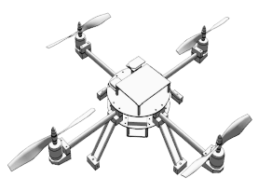
Motivation: Why Considering Perception?
Real-world scenarios may impose serious perception challenges.
To reach a goal safely and accurately, the perception quality has to be considered.
Our idea:
Consider perception in a receding horizon fashion for navigation.
Zichao Zhang – ETH and University of Zurich – Perception-aware Receding Horizon Navigation for MAVs
Notes:
The specific problem we are trying to tackle here is that real-world scenario may impose serious perception challenges.
For example, in this environment, the naïve solution to go straight to the goal is not a good option, because the MAV will go through textureless areas.
Green paths close to the forest will be a better choice instead.
To achieve such behavior, we propose to consider perception quality in a receding horizon fashion for navigation.

Slide 4
Method: Overview
Use two maps:
Dense map: obstacle
Active map: active landmarks
Generate motion primitives.
Evaluate each motion primitive
${ R}_{goal}$: Progress to the goal
$R_{collision}$: Collision risk
${ R}_{perception}$: Perception quality
Maximize $Reward=f(R_{collision}, { R}_{goal}, { R}_{perception})$
Zichao Zhang – ETH and University of Zurich – Perception-aware Receding Horizon Navigation for MAVs
Notes:
Our approach uses two maps to represent the knowledge about the environment: a dense map for obstacles and an active map for localization.
We first generate a library of motion primitives within a limited horizon, then evaluate each of the motion primitive for the progress to the goal, the collision risk and the perception quality. Then we select the best one to execute in terms of these metrics. This process is repeated online as new information arrives.

Slide 5
Method: Collision Risk
Use a dense occupancy map
Sample the motion primitives
Calculate the distance from each sample to the nearest point in the dense map.
Zichao Zhang – ETH and University of Zurich – Perception-aware Receding Horizon Navigation for MAVs
Notes:
Better make

Slide 6
Method: Perception Quality
Use the active points from SLAM systems
Sample the motion primitives
For each sample, calculate the Fisher information matrix for a PnP problem
Combine the Fisher information matrix for all the sampled poses
Zichao Zhang – ETH and University of Zurich – Perception-aware Receding Horizon Navigation for MAVs
Notes:
To evaluate the perception quality, we extract the active 3D points from a SLAM system.
For each motion primitive, we sample several poses and calculate the fisher information matrix for each pose.
Then we combine the information matrices for all the samples to calculate the perception quality for this motion primitive.

Slide 7
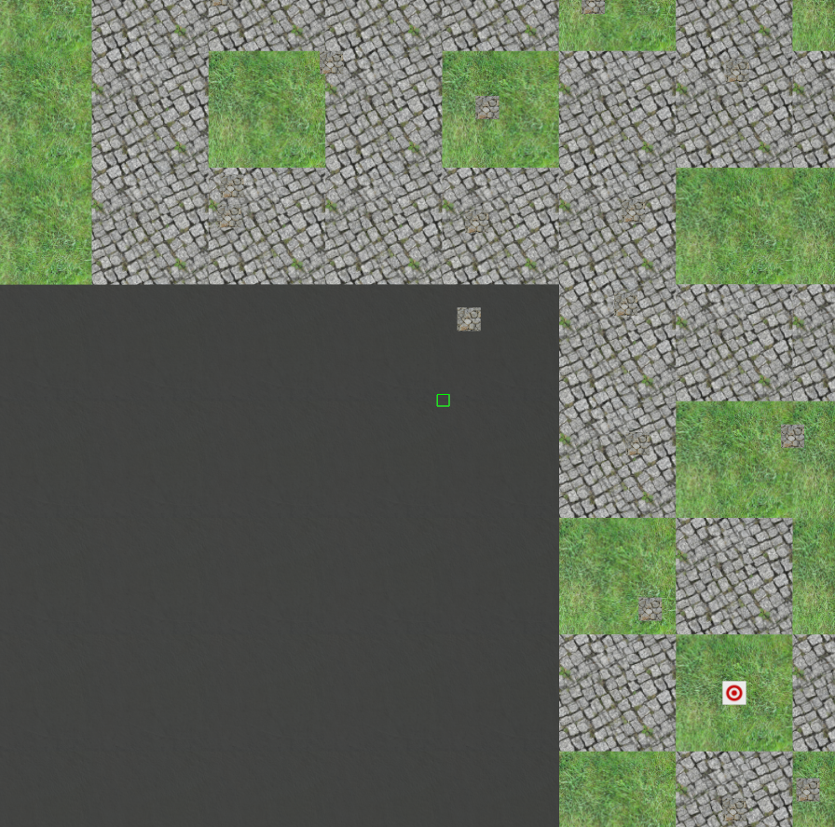
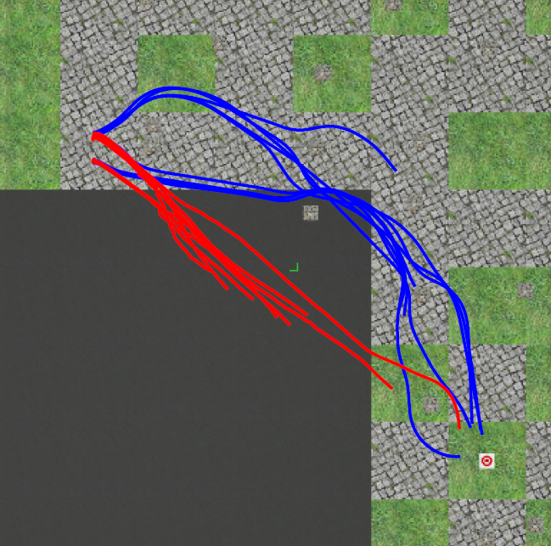
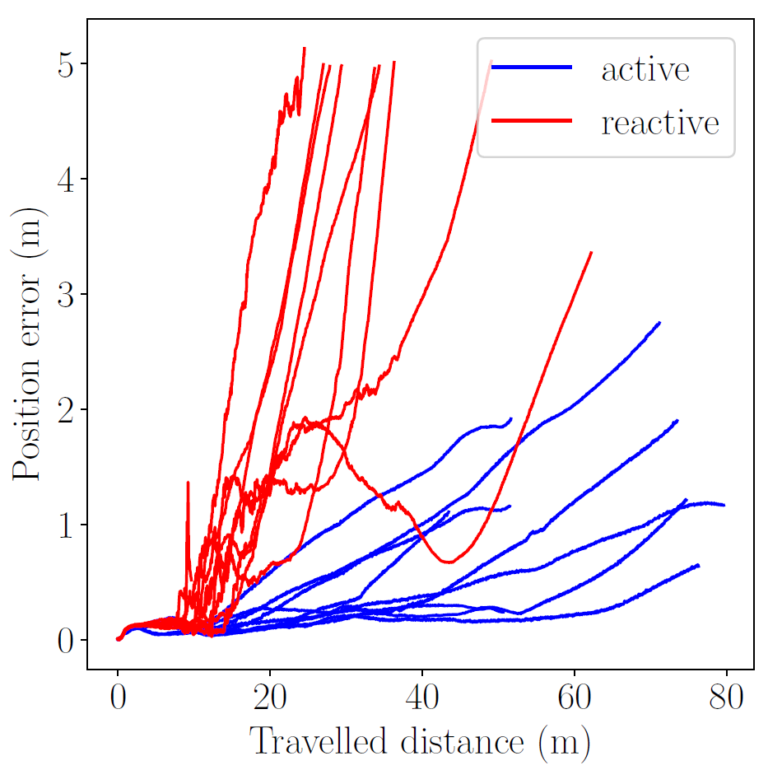
Simulation
Perception-aware
Purely-reactive
Zichao Zhang – ETH and University of Zurich – Perception-aware Receding Horizon Navigation for MAVs
Notes:
We tested our approach in extensive simulations.
In this scenario, our perception-aware method is able to prevent the MAV from entering visually degraded area.
We compared our method with an equivalent method without considering the perception quality, our method achieved higher success rate and lower state estimation error.

Slide 8
Notes:
One interesting thing we observed in our experiment is that, obstacles are repellers, due to the collision risk, and attractors, due to the active features on them.
Our method is able to strike a balance between collision risk and state estimation uncertainty.

Slide 9
Notes:
We also validated our method in a real-world scenario. Our approach is able to command the MAV to follow a visually informative path to the goal.

Slide 10
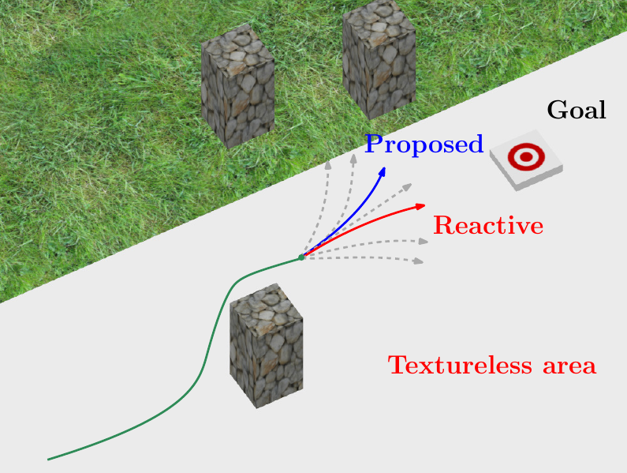
Summary
A navigation approach that combines
Perception quality
Collision risk
Progress to the goal
Simulated and real-world experiments show that our approach outperforms a purely-reactive one, especially in environments with poor texture.
Zichao Zhang – ETH and University of Zurich – Perception-aware Receding Horizon Navigation for MAVs
Notes:
To summarize, we propose to combine perception quality, collision risk and the progress to the goal in a receding horizon setting. Our approach enables better robustness and accuracy in environments with visually degraded areas.

Slide 11
rpg.ifi.uzh.ch

