Slide 1


Onboard State Dependent LQR
for Agile Quadrotors
Philipp Foehn, Davide Scaramuzza
rpg.ifi.uzh.ch
Department of Neuroinformatics
Department of Informatics
Notes:
<number>

Slide 2
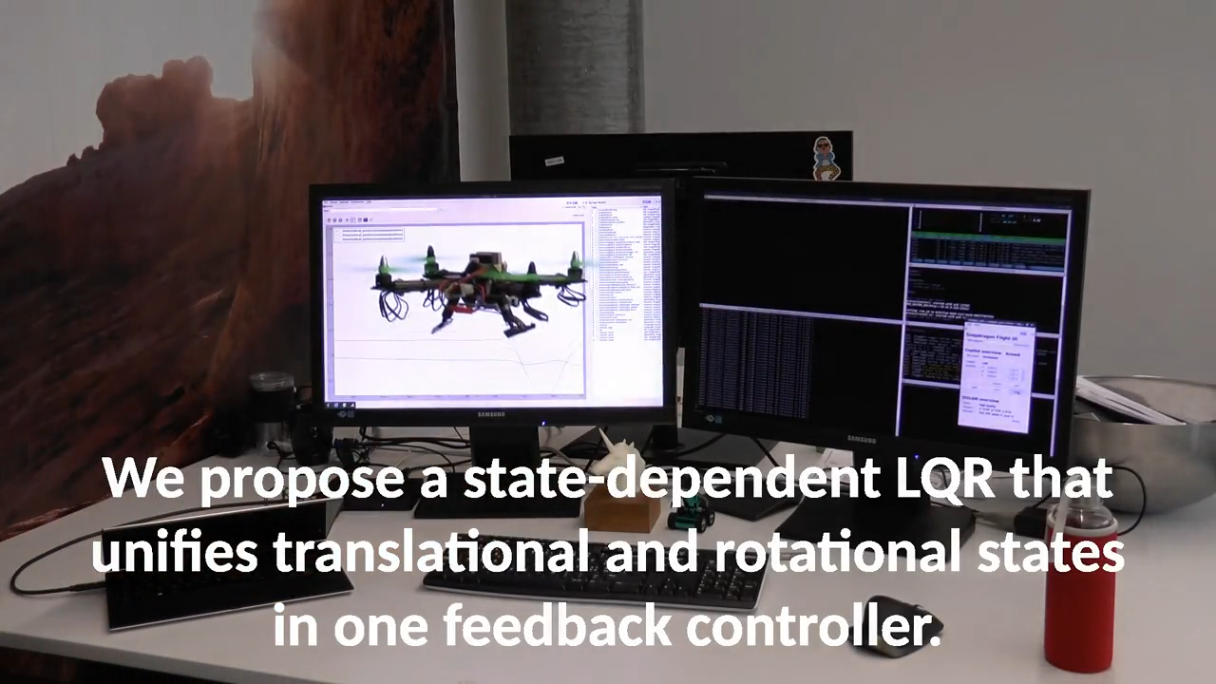

Slide 3

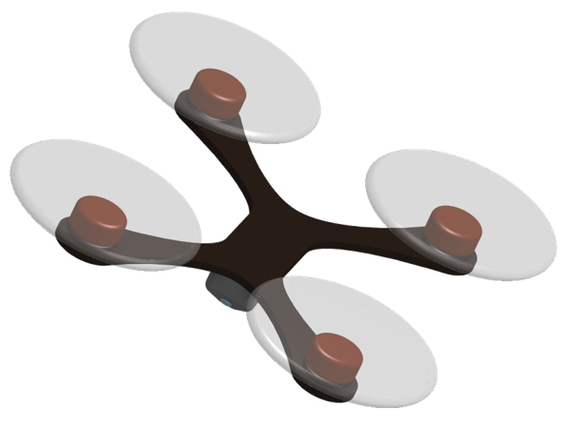
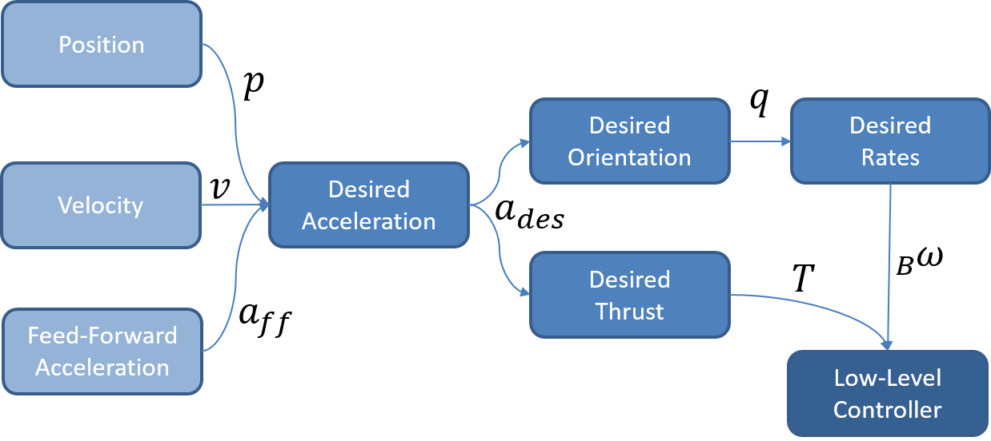
Motivation
$a_{des}$
Quadrotor dynamics: underactuated
→ align orientation with acceleration direction
Classic Quadrotor Control
  cascaded control, drops attitude
  tuning and saturation

Slide 4







Cascaded Quadrotor Control
Position
$p$
$q$
Desired
Orientation
Desired
Rates
Velocity
$v$
Desired
Acceleration
$a_{des}$
${}_{B}^{}ω$
Desired
Thrust
$T$
$a_{ff}$
Feed-Forward
Acceleration
Low-Level
Controller

Slide 5



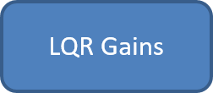

Linear Quadratic Regulator
Position
$p$
${}_{B}^{}T,{}_{B}^{}ω$
Velocity
$v$
Low-Level
Controller
$q$
Orientation

Slide 6


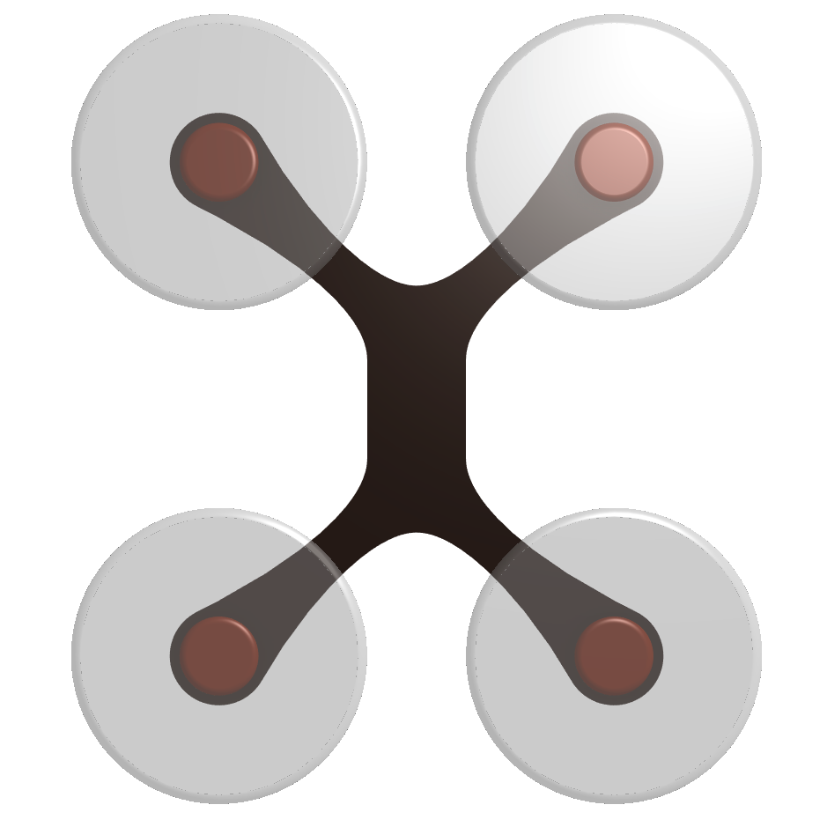
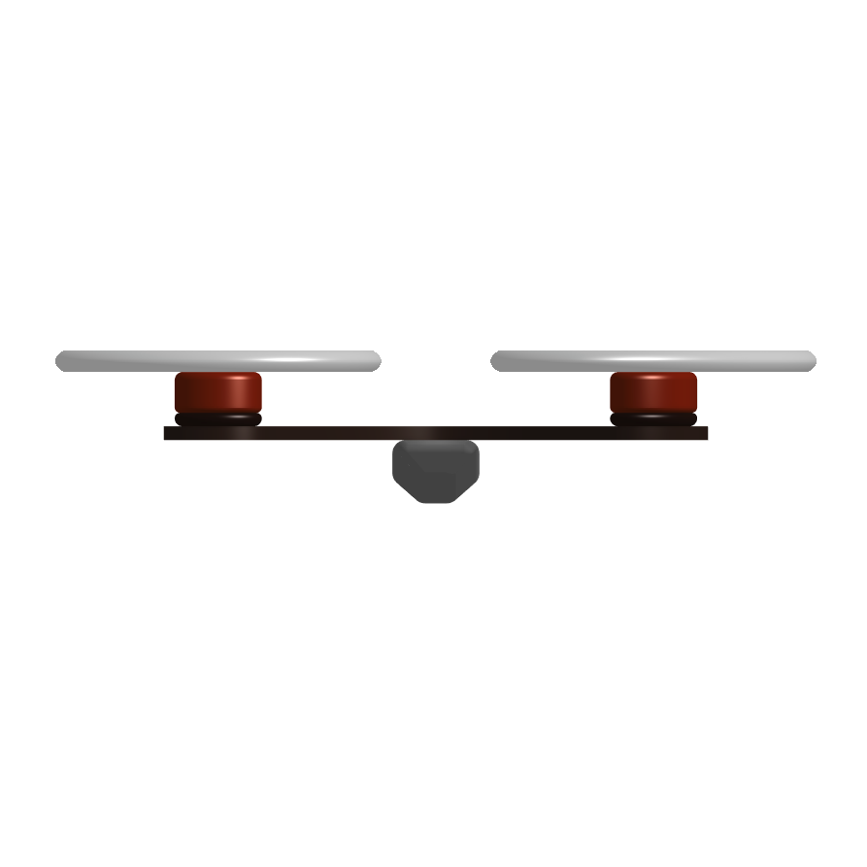
Problem: Linearization
World Frame
System States: q,
Linearization Error
Body Frame
System States: ω
X
X
z
z
y
y

Slide 7
Problem: Linearization
World Frame
System States: q,
Linearization Error
Body Frame
System States: ω
X
X
z
y
z
y

Slide 8
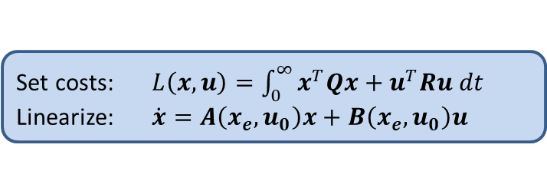

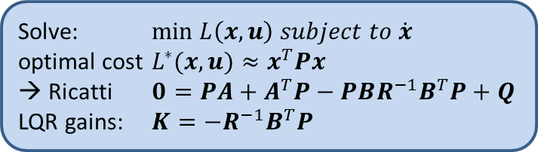

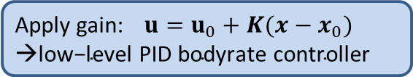

Solution: State-Dependent LQR
Set costs:
Linearize:
State Estimate →
Solve:
optimal cost
→ Ricatti
LQR gains:
$10Hz$
Real system dynamics
Apply gain:
$100Hz$

Slide 9

Experiments

Slide 10
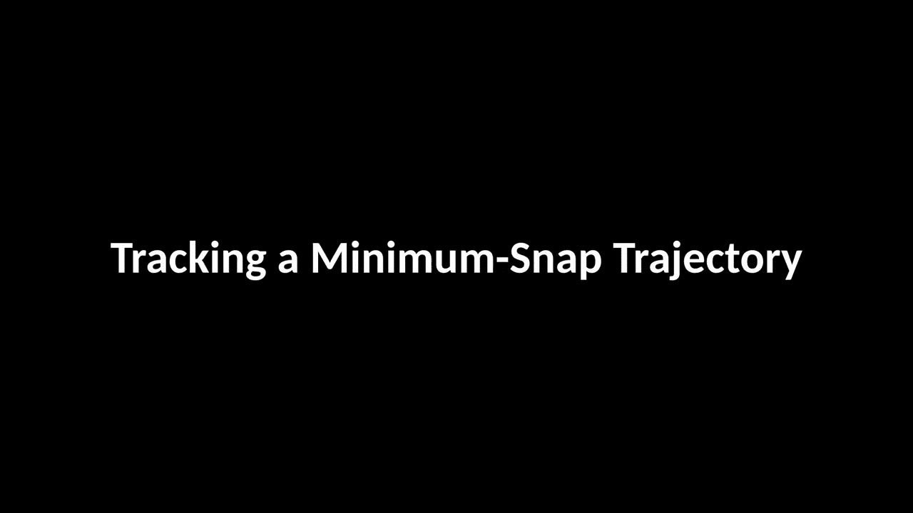

Slide 11

rpg.ifi.uzh.ch

