Slide 1


A Benchmark Comparison of Monocular
Visual-Inertial Odometry Algorithms
for Flying Robots
Jeffrey Delmerico and Davide Scaramuzza
rpg.ifi.uzh.ch
Department of Neuroinformatics
Department of Informatics
Notes:
1

Slide 2
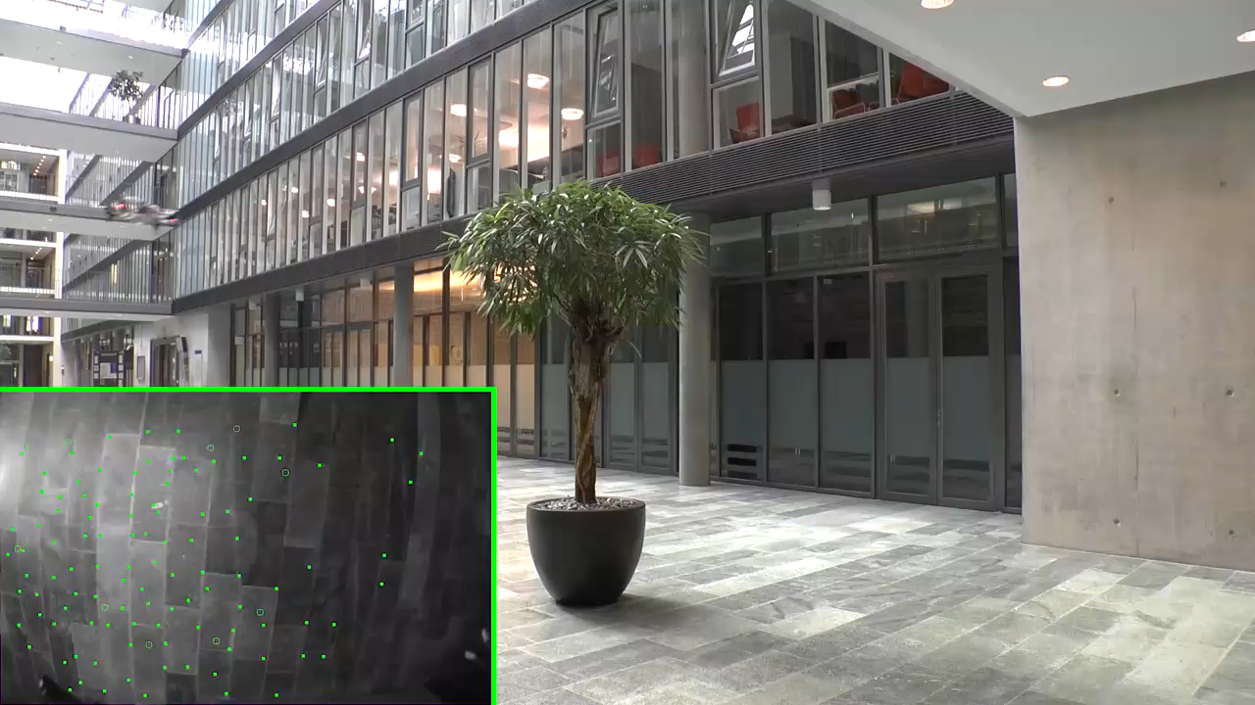
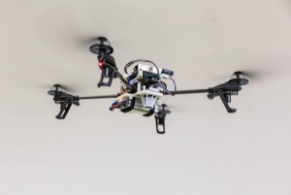
Monocular visual-inertial odometry (VIO) is popular for state estimation on flying robots.

Slide 3
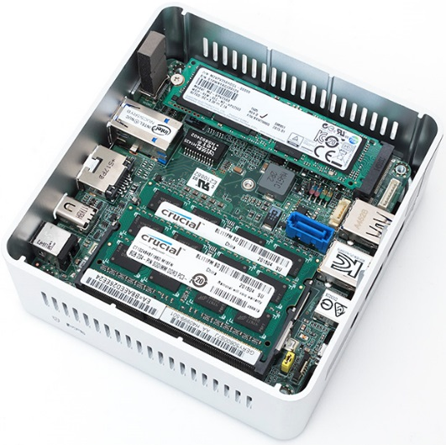
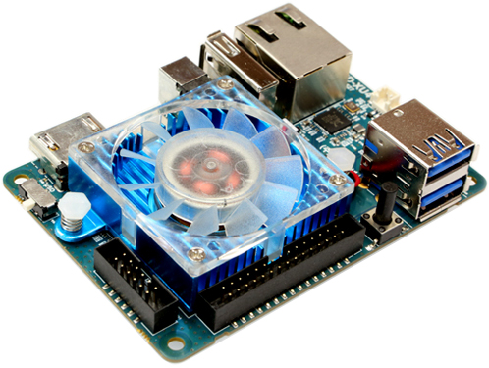
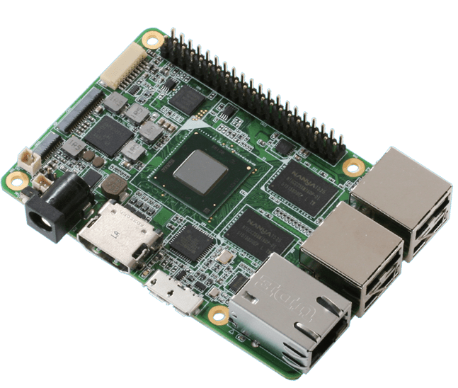
But due to power and weight constraints, flying robots must carry single-board computers with limited computational power.
Intel NUC
Odroid XU4
Up Board

Slide 4
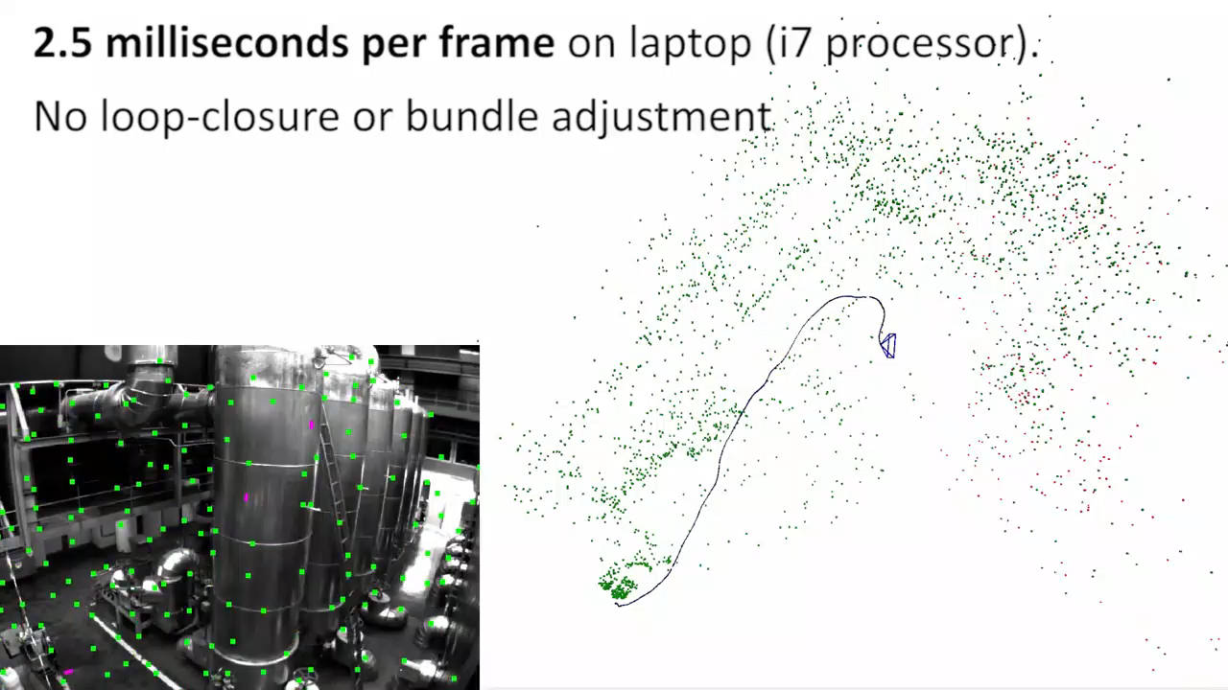
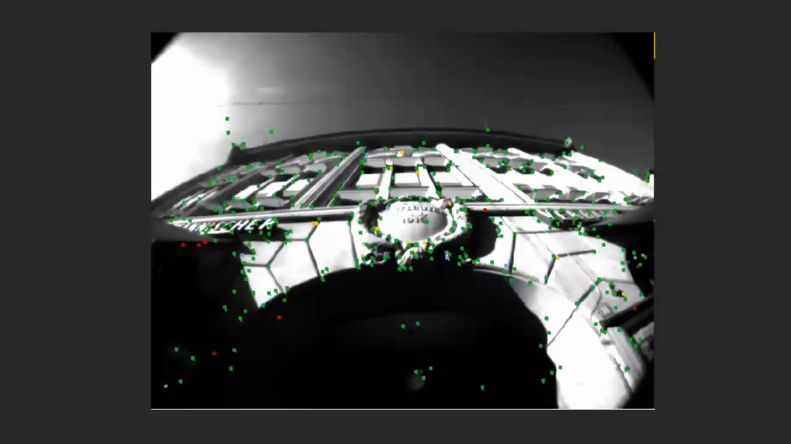
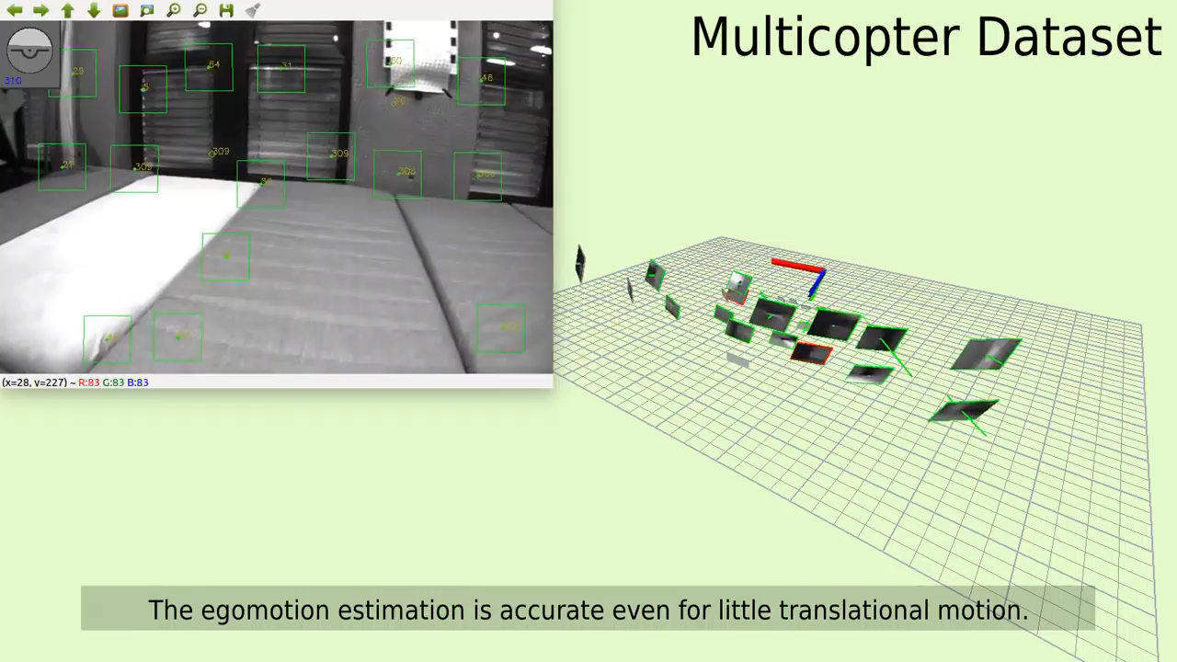
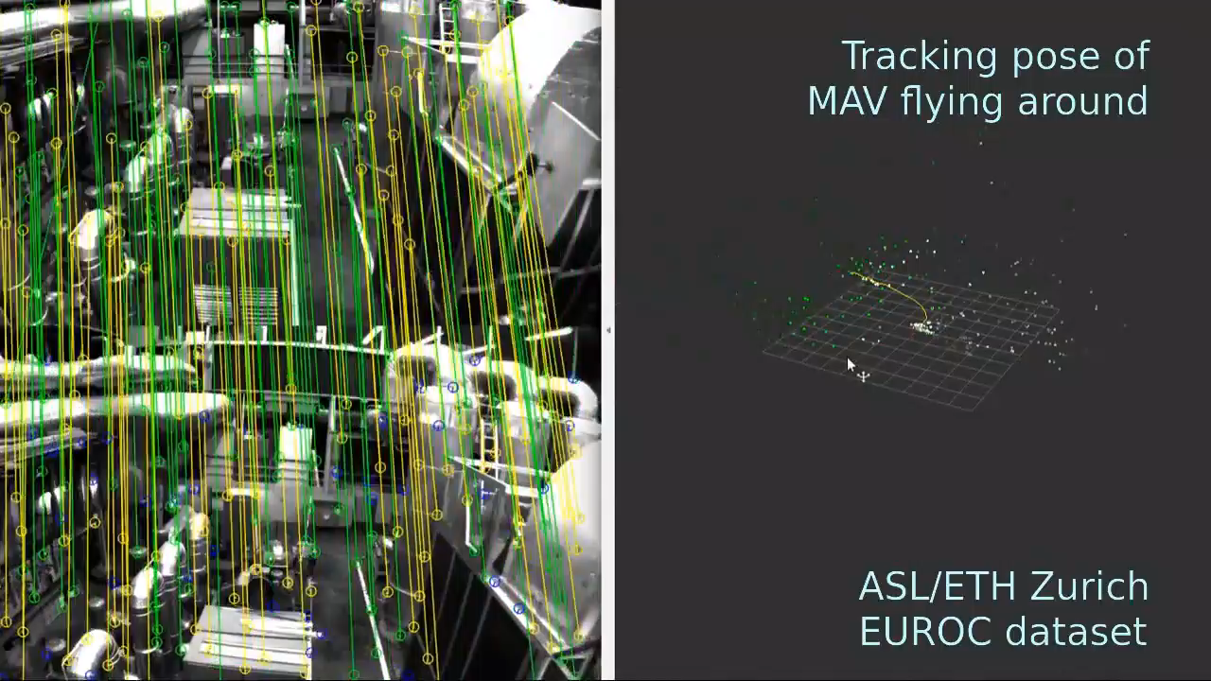
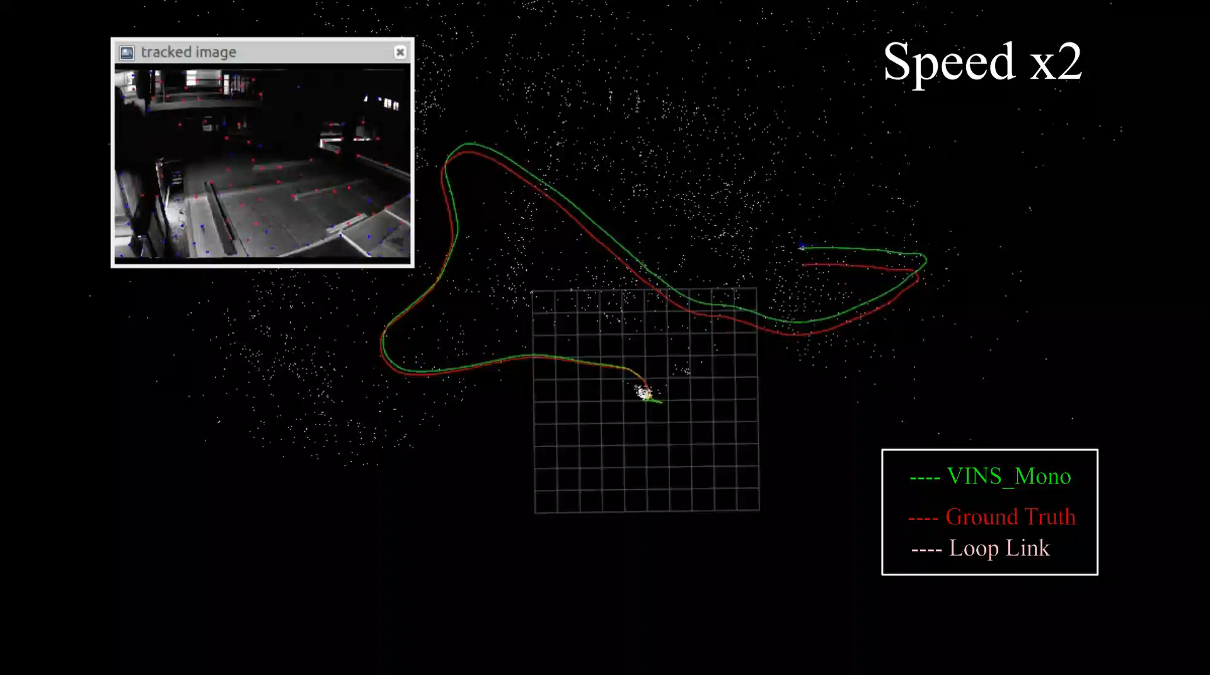
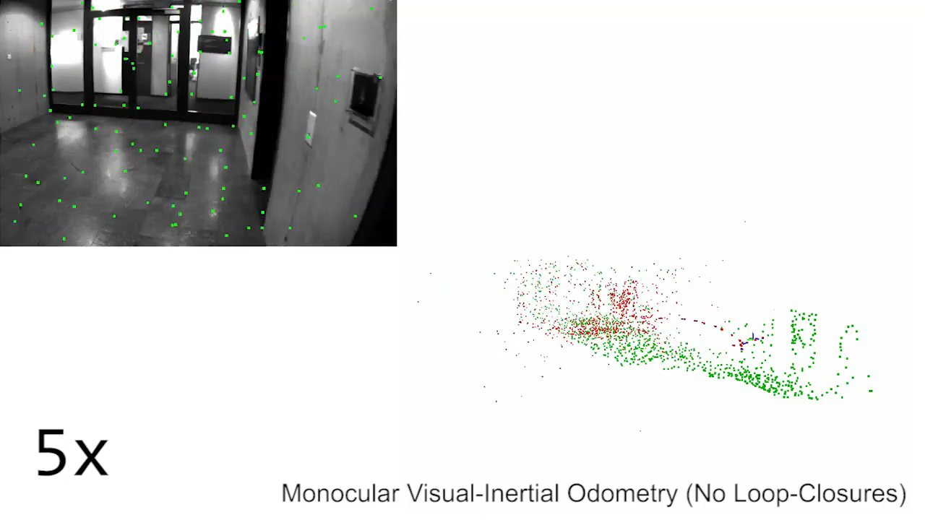
There are many open source or publicly available VIO algorithms
SVO+MSF
MSCKF
ROVIO
OKVIS
VINS-Mono
SVO+GTSAM
but it’s not clear how well these algorithms perform for state estimation with the resource constraints of embedded computers.

Slide 5
We address the question:
Given limited computational resources, what is the best VIO algorithm for flying robot state estimation?
In terms of:
Accuracy
CPU Usage
Memory Utilization
Processing Time

Slide 6
VIO Algorithms
HW Platforms
SVO+MSF
MSCKF
ROVIO
OKVIS
VINS-Mono
SVO+GTSAM
i7 Laptop (Reference)
Intel NUC
Up Board
Odroid XU4
To answer it, we tested all of the publicly available VIO algorithms on the single board computers that are typically found on flying robots.
These algorithms include
loosely-coupled
and tightly-coupled VIO
as well as
filtering-
and optimization-based approaches.

Slide 7
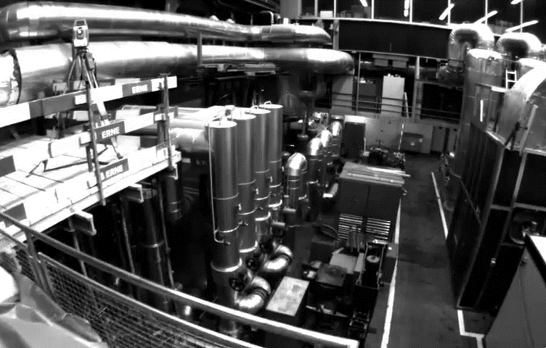
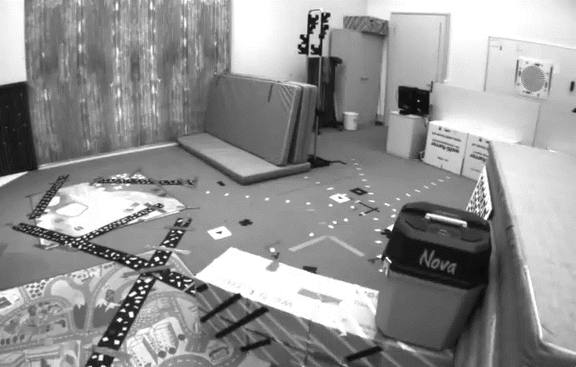
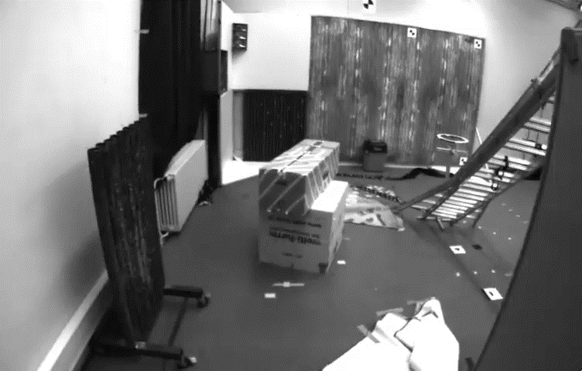
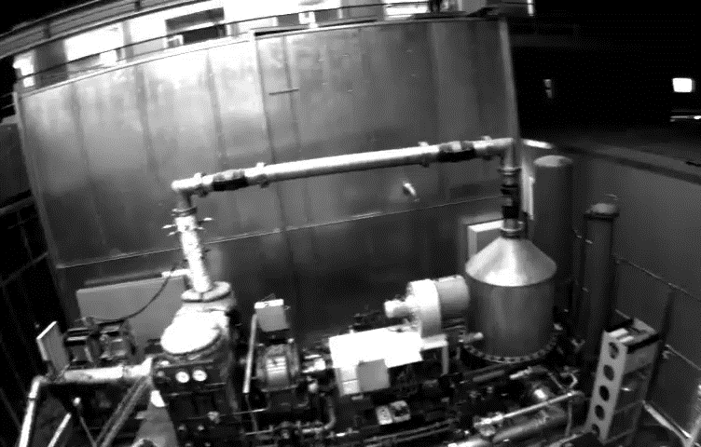
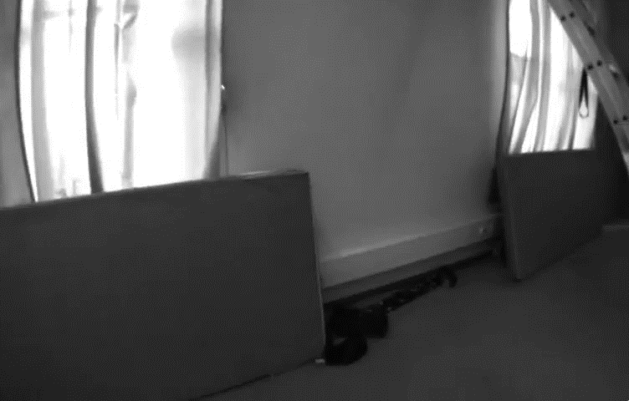
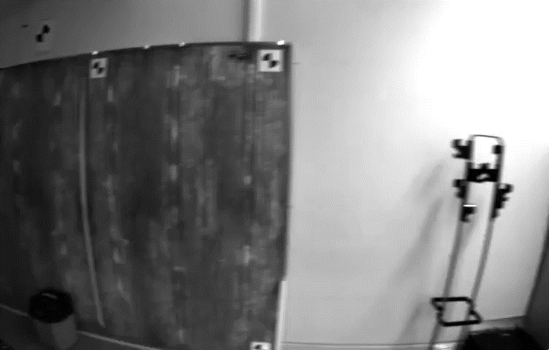
We ran each algorithm on the 11 sequences in the EuRoC MAV dataset.

Slide 8
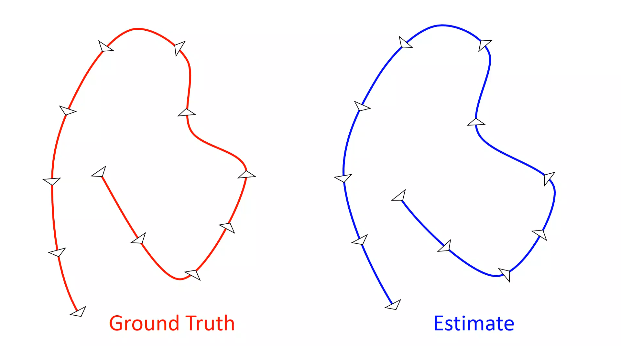
We evaluated accuracy in pose estimation with two metrics:
Root-Mean-Square Error (RMSE): align full estimated trajectory with ground truth; compute RMSE over all poses.

Slide 9
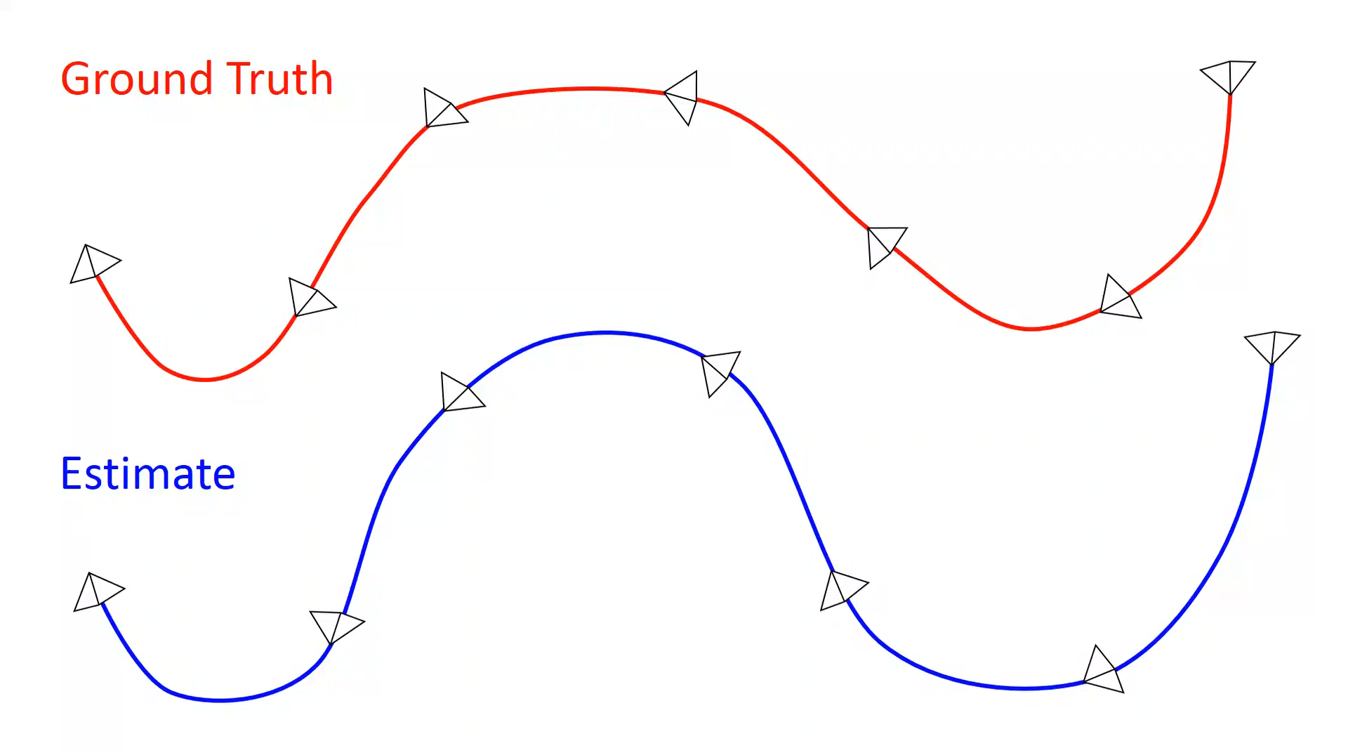
Odometric Error: compile error statistics over all sub-trajectories of a given length by aligning the first pose of each one with its corresponding ground truth pose, and measuring the drift at the last pose in the sub-trajectory.

Slide 10
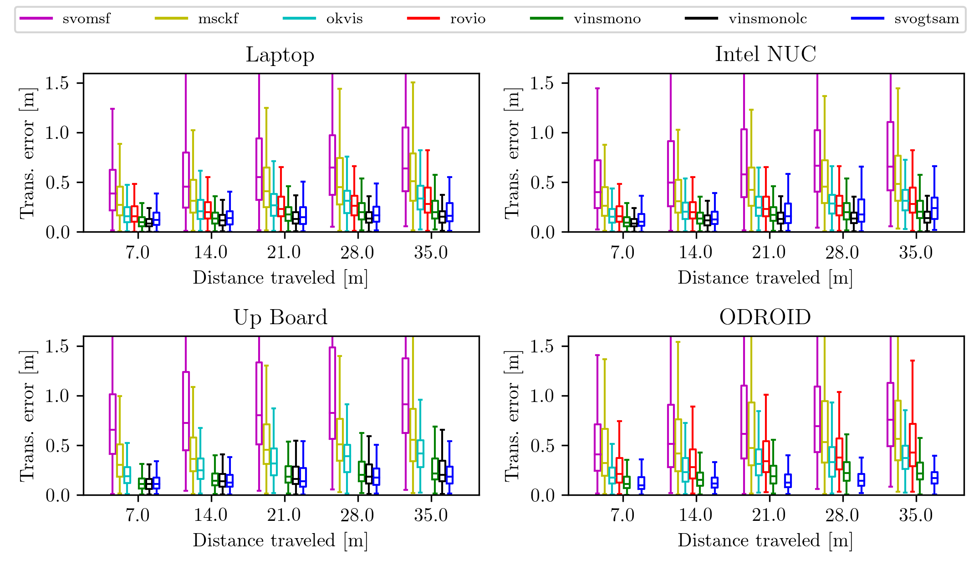
Odometric error results show the algorithm accuracy and robustness.

Slide 11
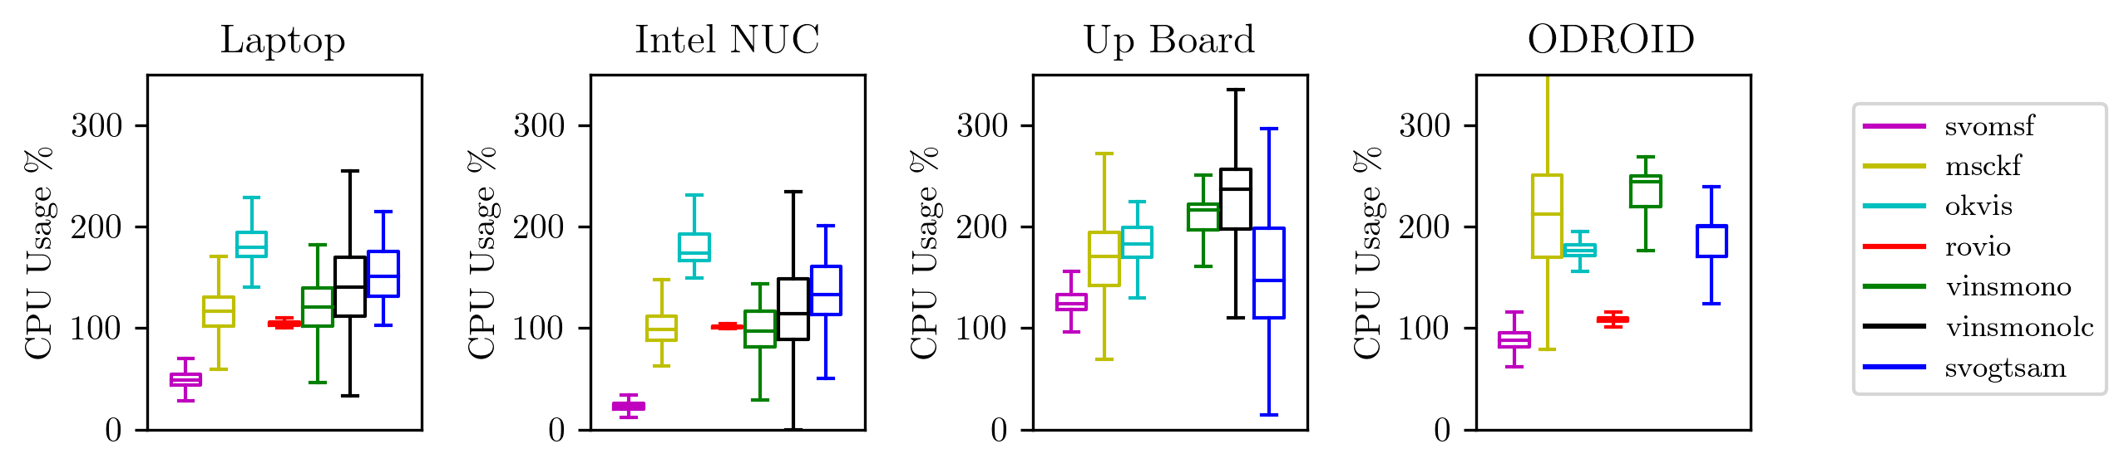
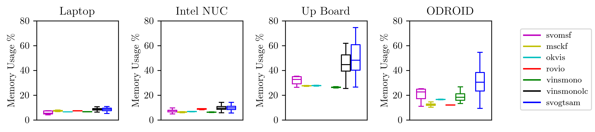
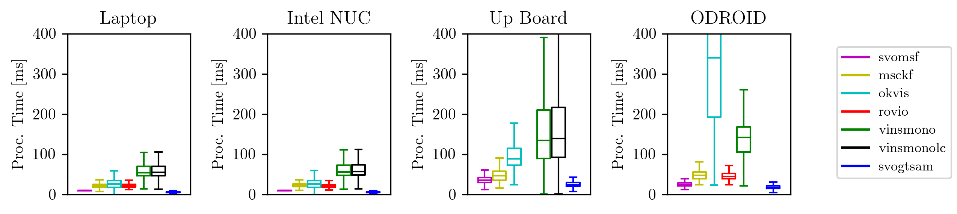
We also measure efficiency in terms of CPU, memory, and processing time.

Slide 12
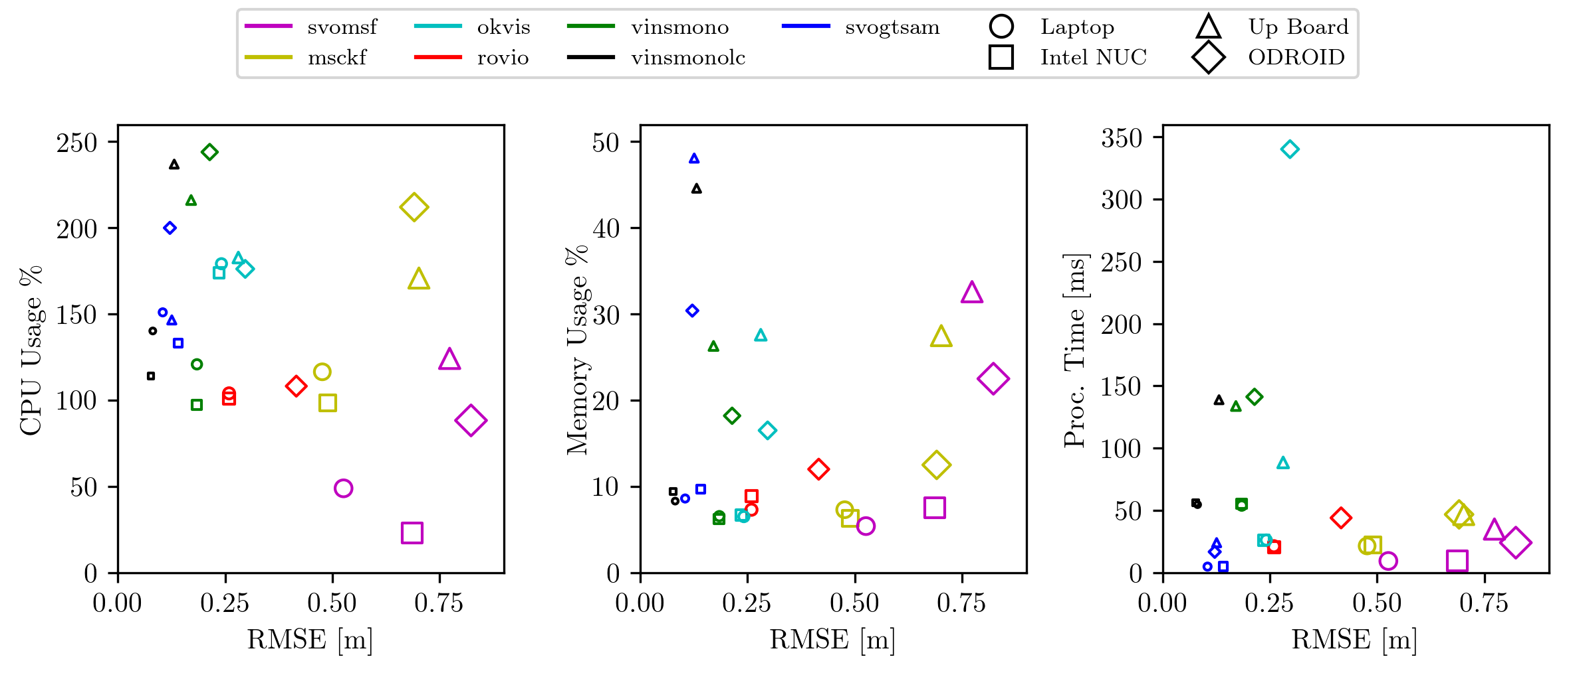
RMSE and resource usage give insight into the tradeoffs between accuracy and efficiency.
SVO+GTSAM: high accuracy and modest resource use, but lack of robustness due to numerical instability in GTSAM optimization.
ROVIO: tight bound on resource usage, competitive accuracy, but unable to run on Up Board due to its low clock speed.
VINS-Mono: consistently robust and accurate, even more with loop closure enabled, but high resource usage.
MSCKF: successful on all sequences, but achieves lower accuracy than more modern algorithms.
SVO+MSF: most efficient but least accurate.
OKVIS: consistent performance across all HW platforms, but low update rate on the ODROID.

Slide 13

rpg.ifi.uzh.ch

