Slide 1


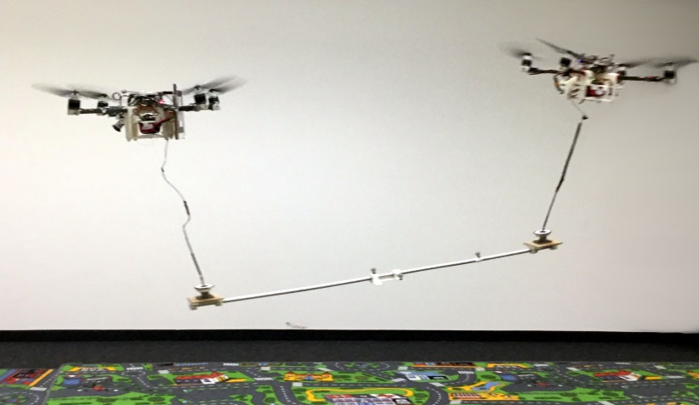
Michael Gassner, Titus Cieslewski, Davide Scaramuzza
Dynamic Collaboration without Communication:
Vision-Based Cable-Suspended Load Transport with Two Quadrotors
Notes:
Uni ZH!
Read the title slower

Slide 2

Problem Statement
Transport a load that is too heavy for just one quadrotor
Should be as simple as possible
How do humans do it?
Friends – The one with the cop
Not much explicit communication is needed!
T. Cieslewski – University of Zurich – Dynamic Collaboration without Communication
Notes:
Transport too heavy
In a simple; simplest
Humans? adapts
No comm!

Slide 3
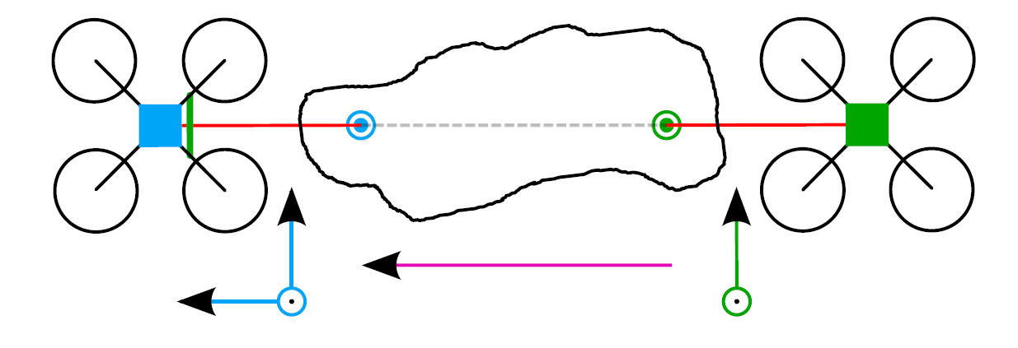

Leader-Follower Approach
Split control over degrees of freedom among robots
  Leader controls $x, y, z$ of the load
  Follower controls $pitch, yaw$of the load
Eliminate any necessity for communication: Make follower passive!
  $Pitch$: Track altitude of leader
  $Yaw$: Don’t move laterally
T. Cieslewski – University of Zurich – Dynamic Collaboration without Communication
Notes:
Split DoF
How
Eliminate necessity for comm: Passive follower. How?

Slide 4
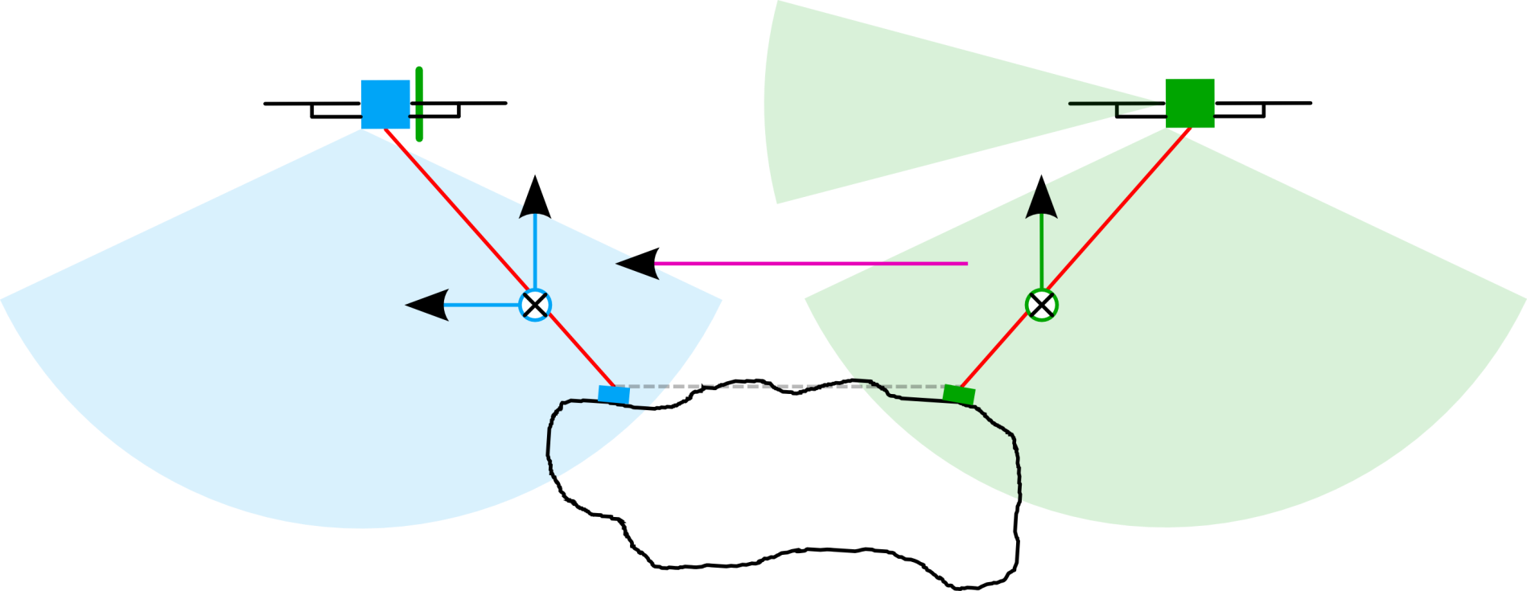
Perception
Both quadrotors: Downlooking fisheye for pose estimation and object gripper tracking
Follower: Forward looking pinhole for leader tracking
Fully on-board state estimation with vision and IMU
T. Cieslewski – University of Zurich – Dynamic Collaboration without Communication

Slide 5
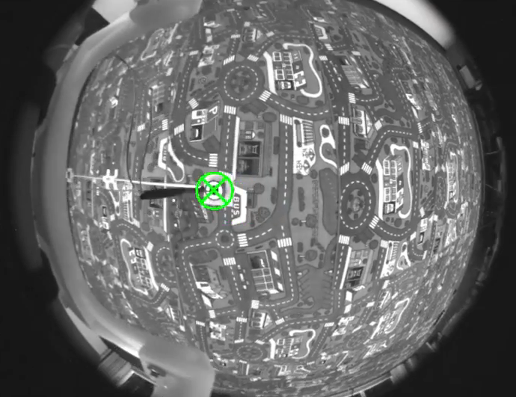
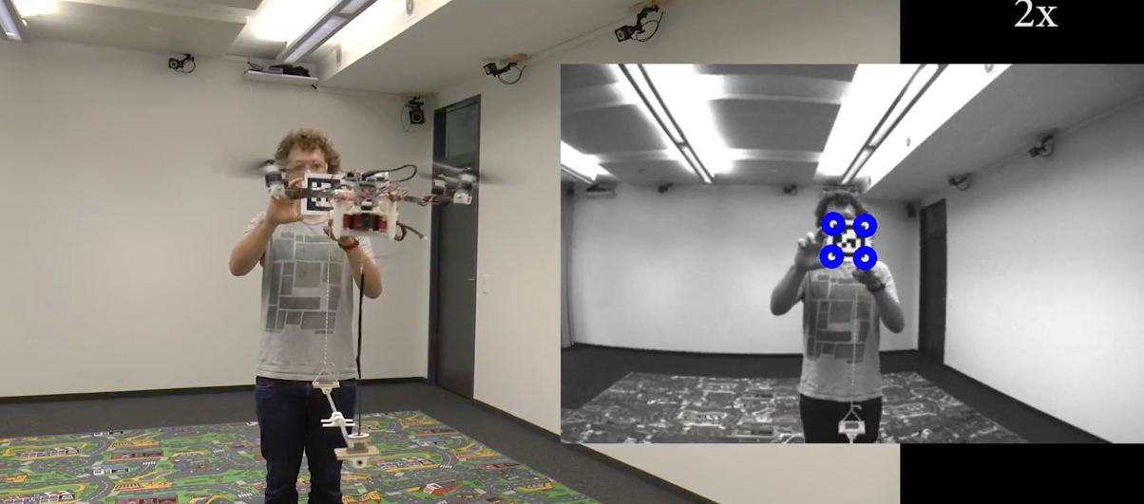
LQR Slung-load Control
Leader and follower control load gripper pose as if it were a single slung-load.
Follower only controls lateral position
Reducing oscillations for robustness
Follower tracks leader’s altitude and moving direction with visual servoing
T. Cieslewski – University of Zurich – Dynamic Collaboration without Communication
Notes:
1. Gripper tracking (expand more; add side view of quads + cameras/vision)
2. Leader tracking

Slide 6
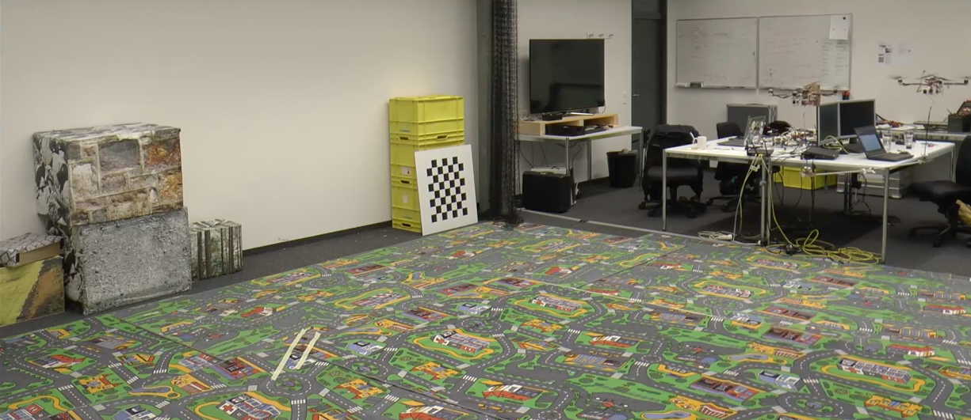
Summary
Collaborative load transport
No communication or explicit relative localization needed!
Everything is done fully on-board using only vision and IMU
Quantitative results presented at interactive session
T. Cieslewski – University of Zurich – Dynamic Collaboration without Communication
Notes:
Move vision ahead!

