Slide 1


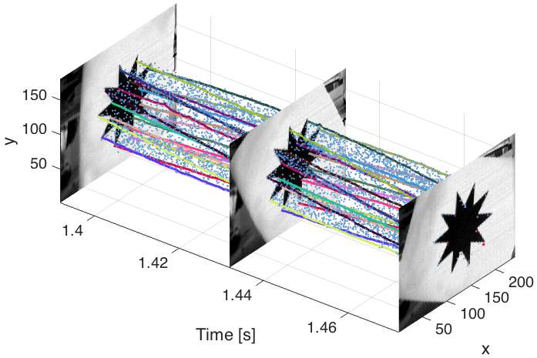
Feature Detection and Tracking with the
Dynamic and Active-pixel Vision Sensor (DAVIS)
David Tedaldi, Guillermo Gallego,
Elias Mueggler and Davide Scaramuzza

Slide 2
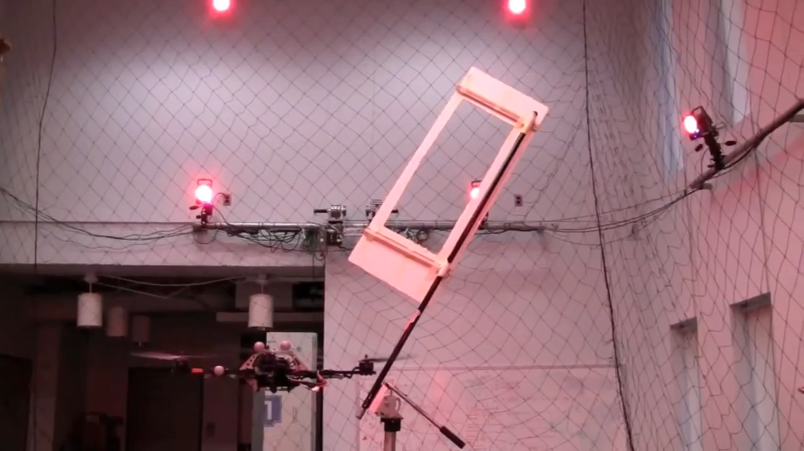
Motivation
Agile Navigation with Flying Robots
[Mellinger et al, ”Trajectory generation and control for precise aggressive maneuvers with quadrotors”, IJRR 2012]

Slide 3
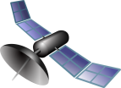
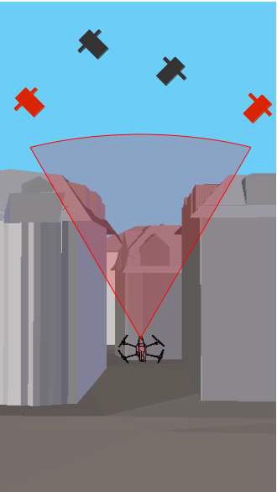
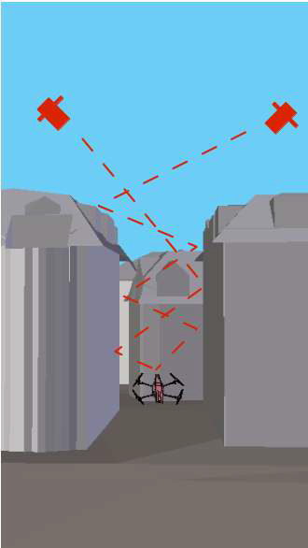
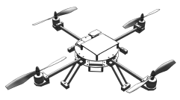
Motivation
Global Positioning System (GPS)?
  Does not work inside or close to structures

Slide 4
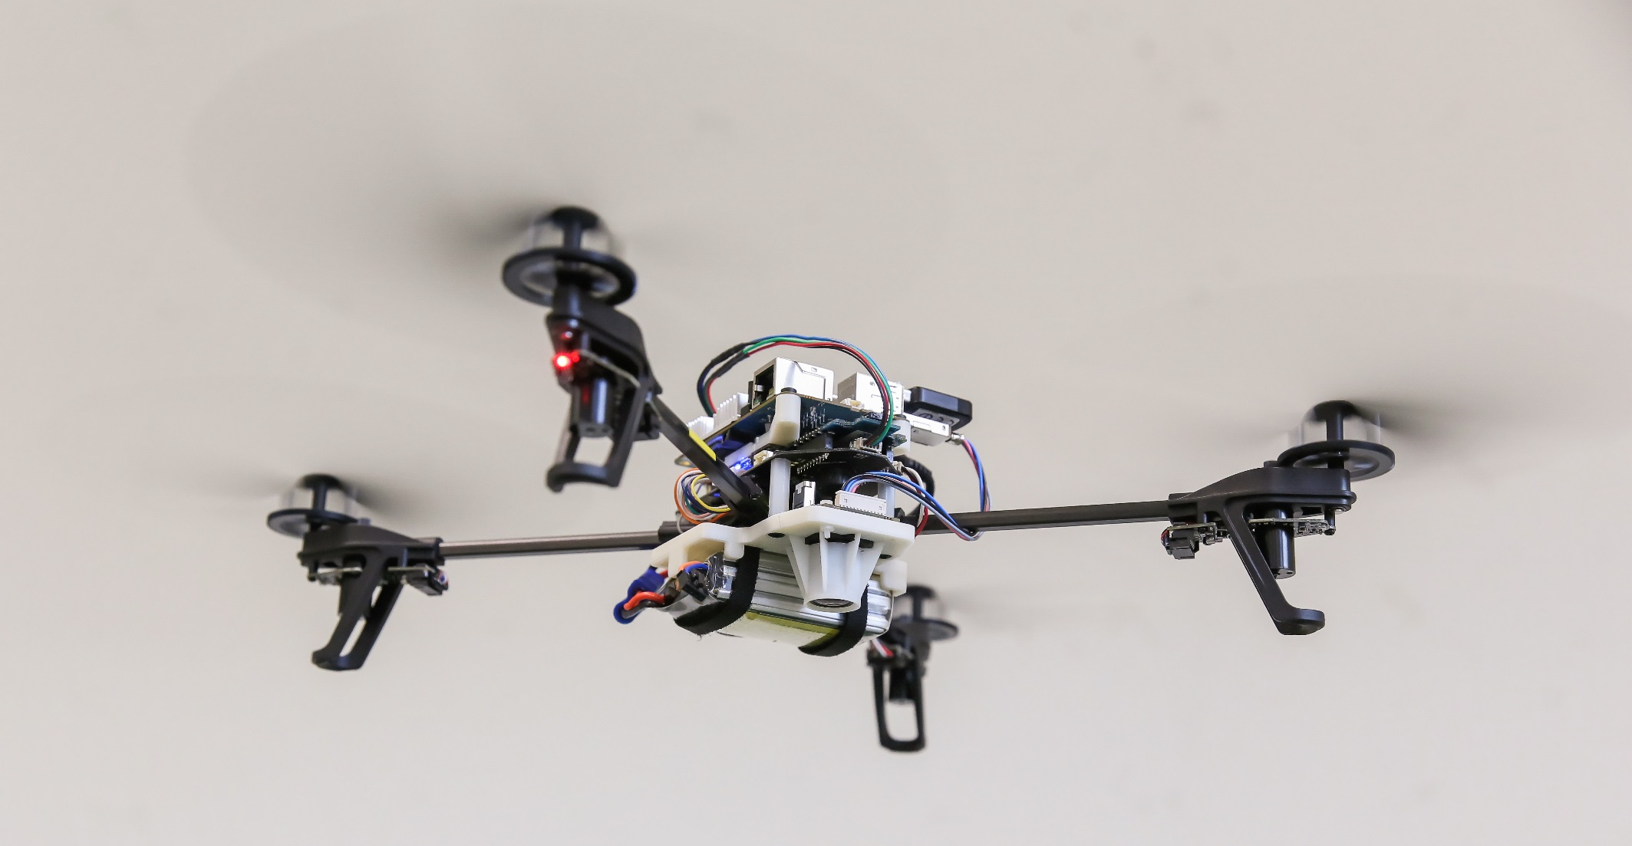
Motivation: Onboard sensors

Slide 5
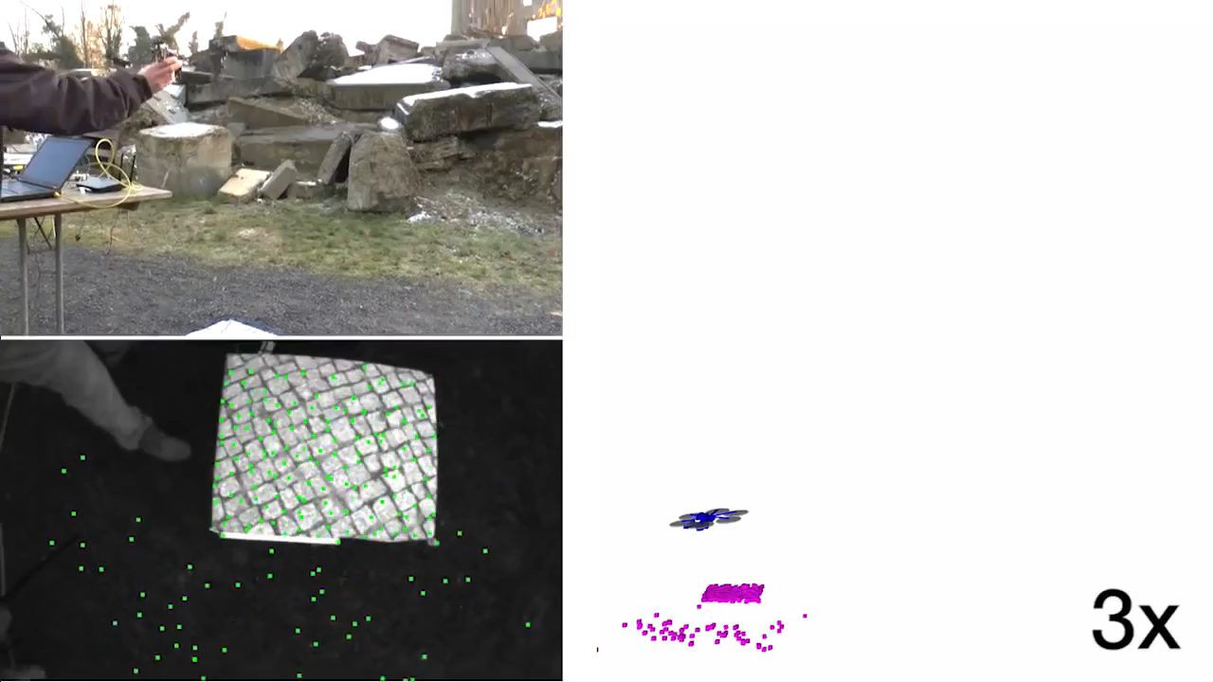
Vision-based Flight with Standard Cameras
[Faessler, Fontana, Forster, Mueggler, Pizzoli, Scaramuzza, “Autonomous, Vision-based Flight and Live Dense 3D Mapping with a Quadrotor Micro Aerial Vehicle”, J. of Field Robotics, 2015]

Slide 6
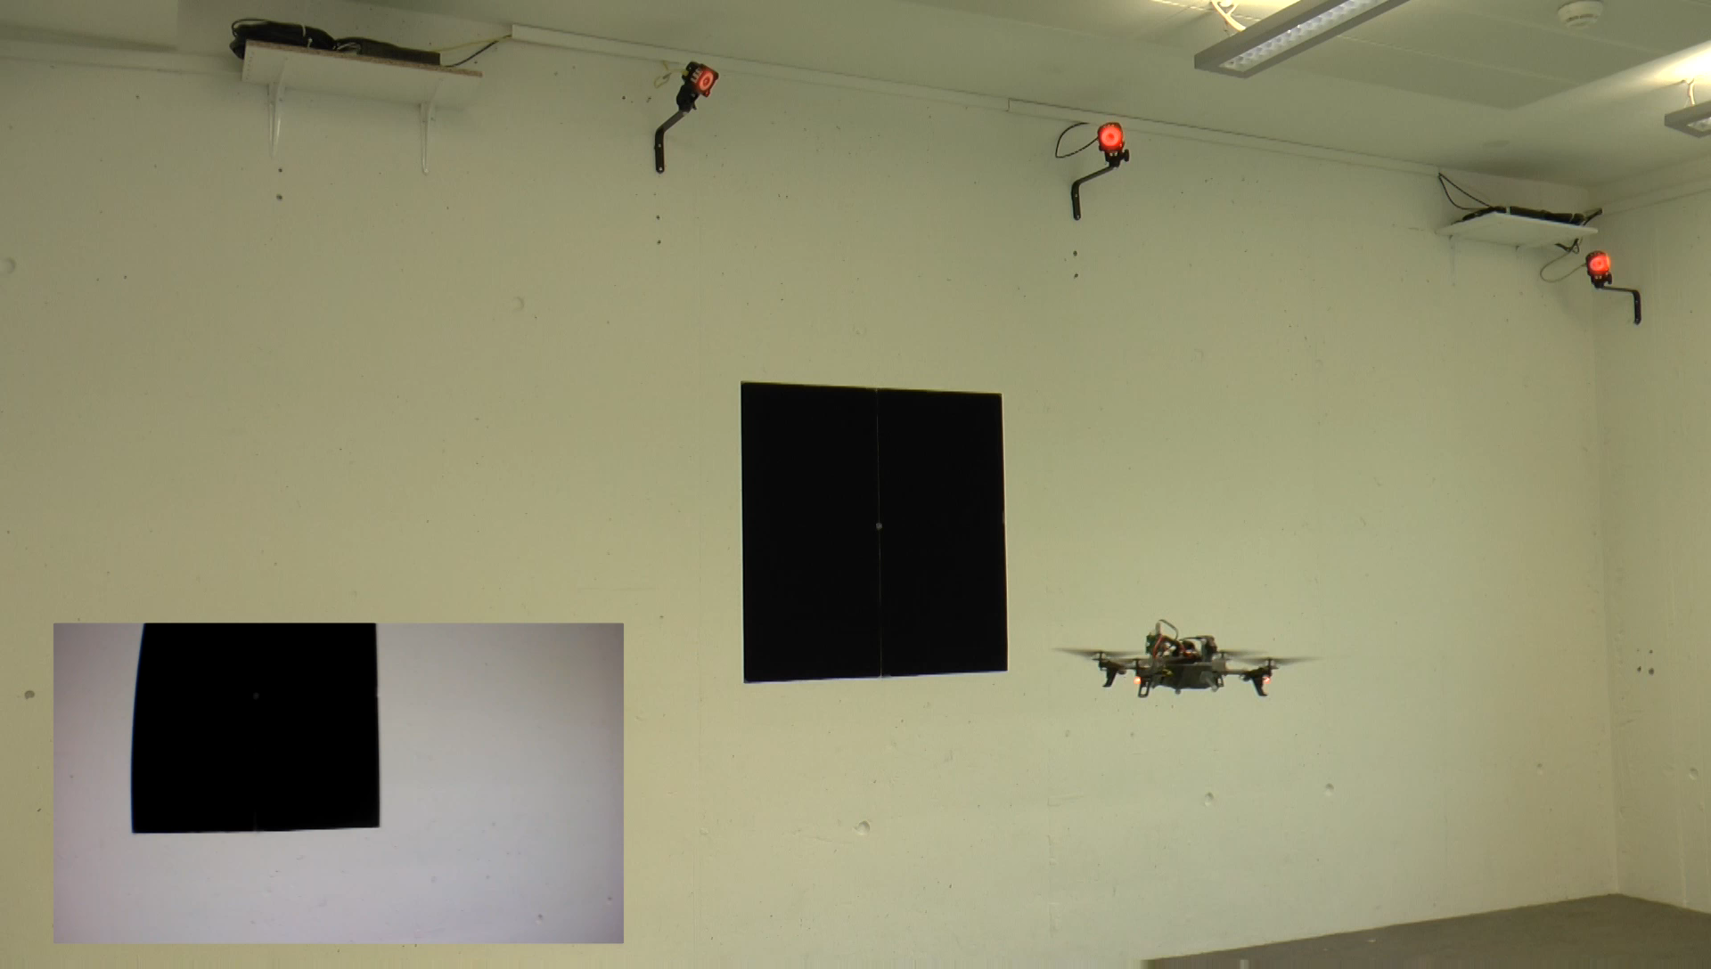
Problem Statement
Visual tracking of high-speed robot maneuvers
  E.g., quadrotor flips (rotational speeds of 1200 deg/s)

Slide 7

Standard camera suffers motion blur

Slide 8
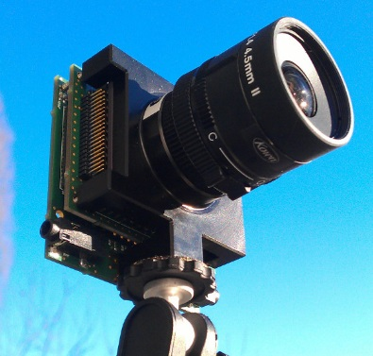

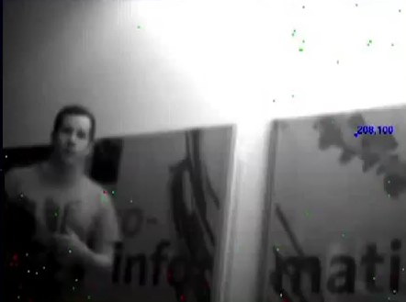
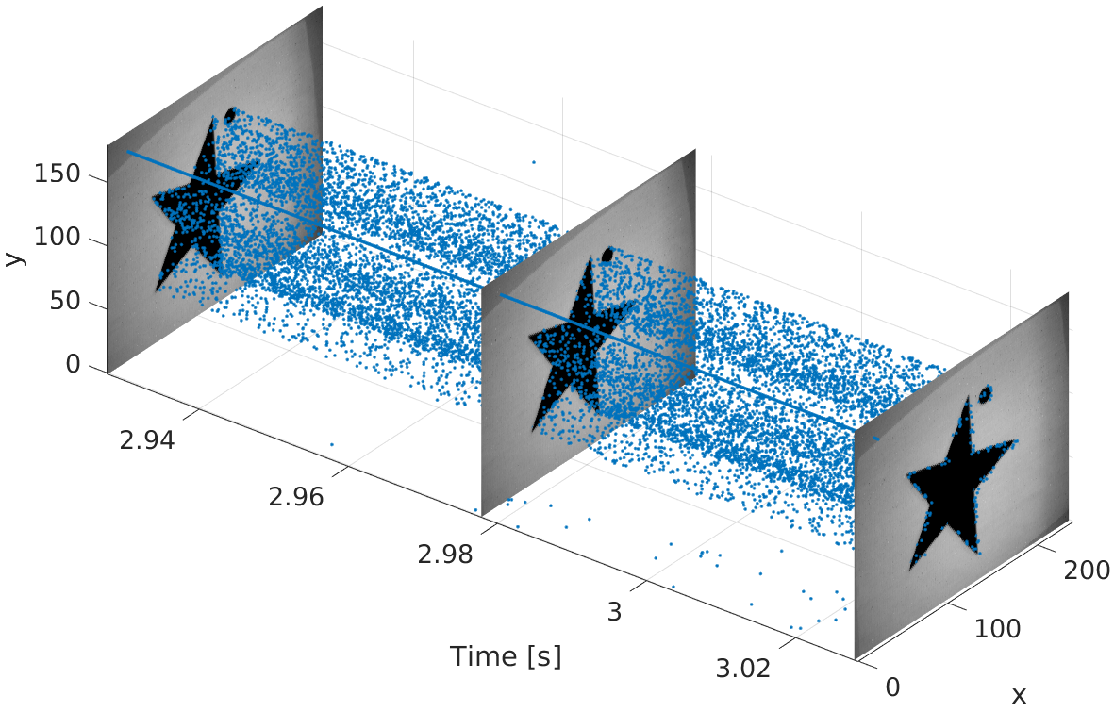
DAVIS:
Dynamic and Active-pixel Vision Sensor
3us latency
240x180 pixels
130dB dynamic range

Slide 9
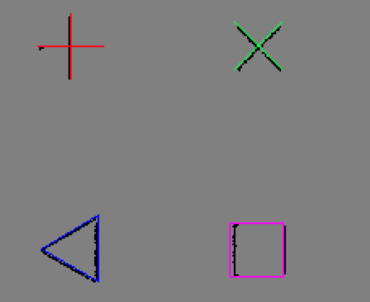

Related Work
Shape Tracking [Ni, TRO’12]
  Pre-defined model/shape
  Event-based Iterative Closest Points (ICP)
Kernel-based Tracking [Lagorce, TNNLS’14]
  Pre-defined kernels
  Large shapes (70 pixels)
  Rotation and translation
  handled differently

Slide 10
Feature Detection and Tracking
Feature Extraction from Frames
  (Harris) corner detection
  (Canny) edge detection
  Yields “model point sets”
Feature Tracking from the Event Stream
  Assignment of events yields “data point sets”
  Registration using Iterative Closest Points (ICP)

Slide 11

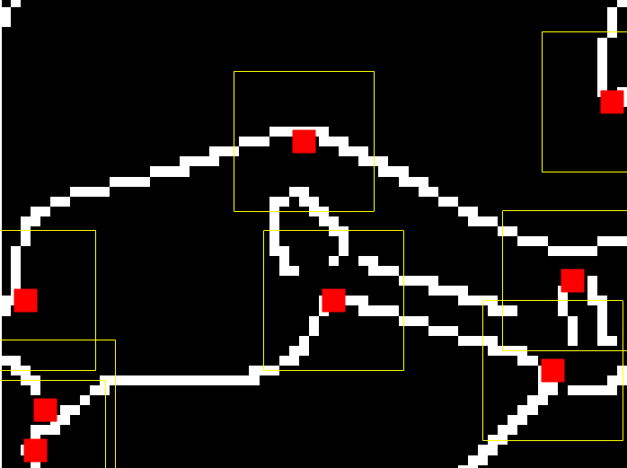
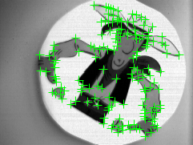
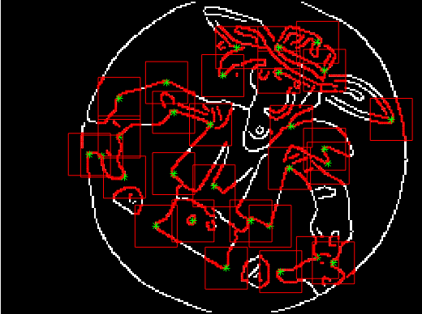
Feature Extraction from Frames
Corner
detection
Edge detection
around corners
Notes:
Fig. 2: Feature detection and tracking. (a) Frame with centers of detected features (green crosses). (b) Edge map (black and
white) and square patches defining the features (i.e, model point sets, in red) (b)-(c) Zoomed views of the data point sets
(i.e., events; blue circles) and model point sets (red stars) of the features, shortly after initialization

Slide 12
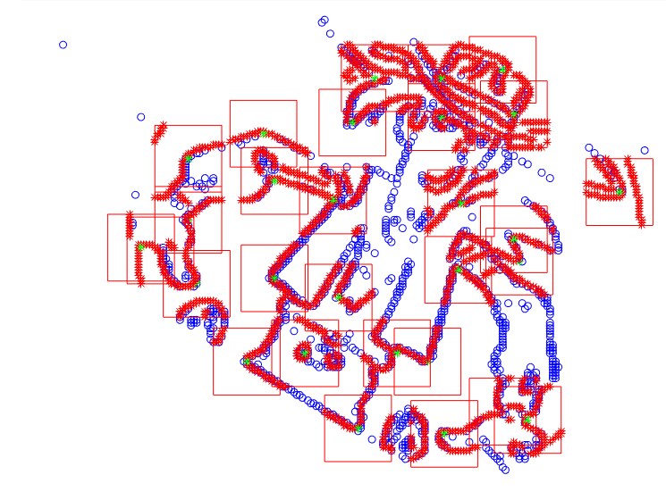
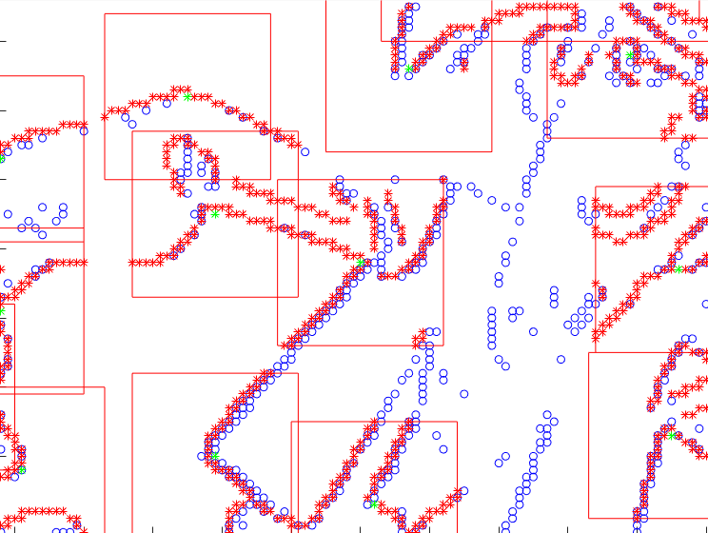
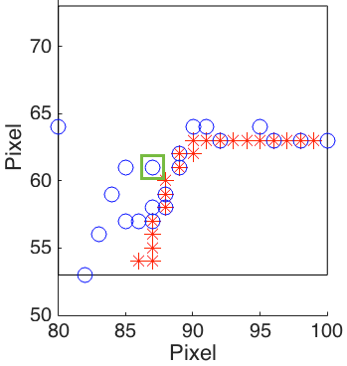
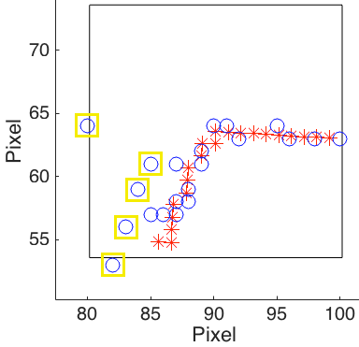
Feature Tracking from the Event Stream
Registration:
Iterative Closest
Points (ICP)
Notes:
A feature tracker, with the model point set (in red), the
data point set (in blue). Same color notation as in Figs. 2c-
2d. The black square represents the patch around the model
point set. (a) Before registration: the current event (in green)
updates the data point set and is used for registration of the
point sets. (b) After registration: the events marked in yellow
are classified as outliers, and the registration parameters are
updated, aligning the model and data point sets.

Slide 13
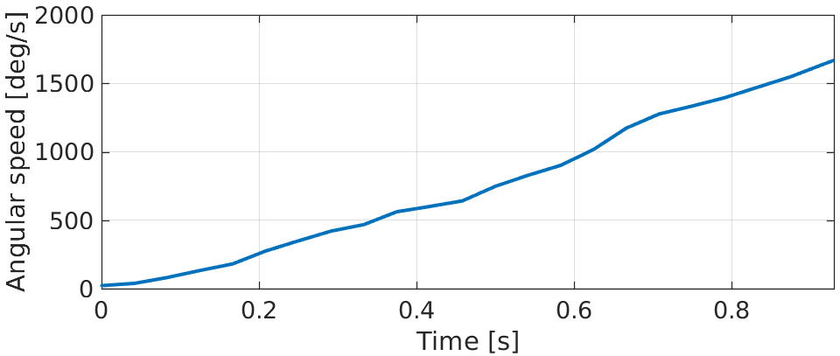
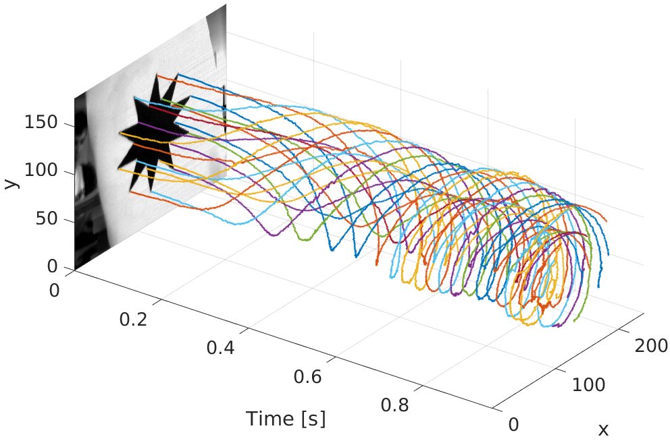
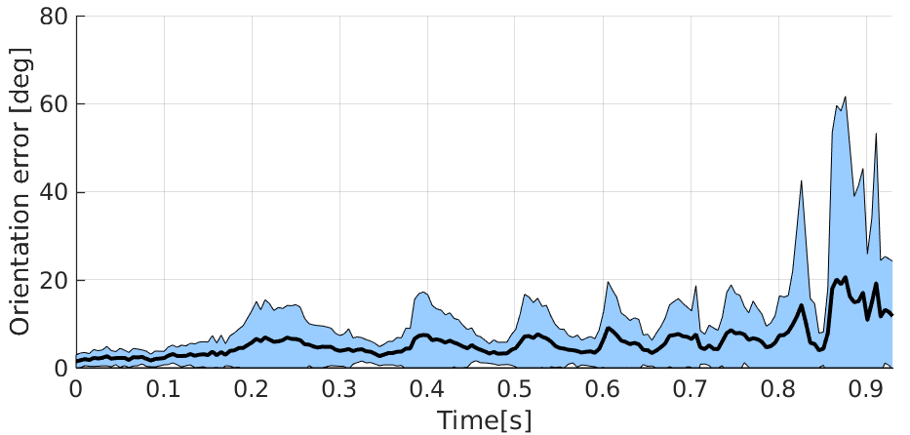
Results: Rotating Star
Acceleration from rest to 1.600°/s
1.800 pixels/s on image plane
Mean error: 6.3°

Slide 14
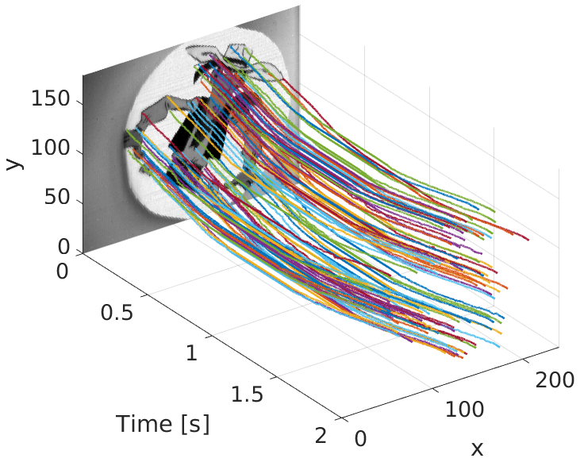
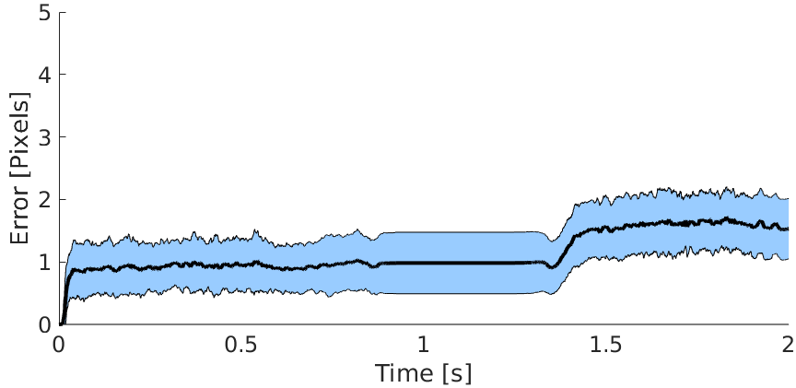
Results: Lucky Luke
Cartoon scene
Back-and-forth translation
81 features
Mean error: 1.22 pixels
Ground truth: image-based feature tracking

Slide 15
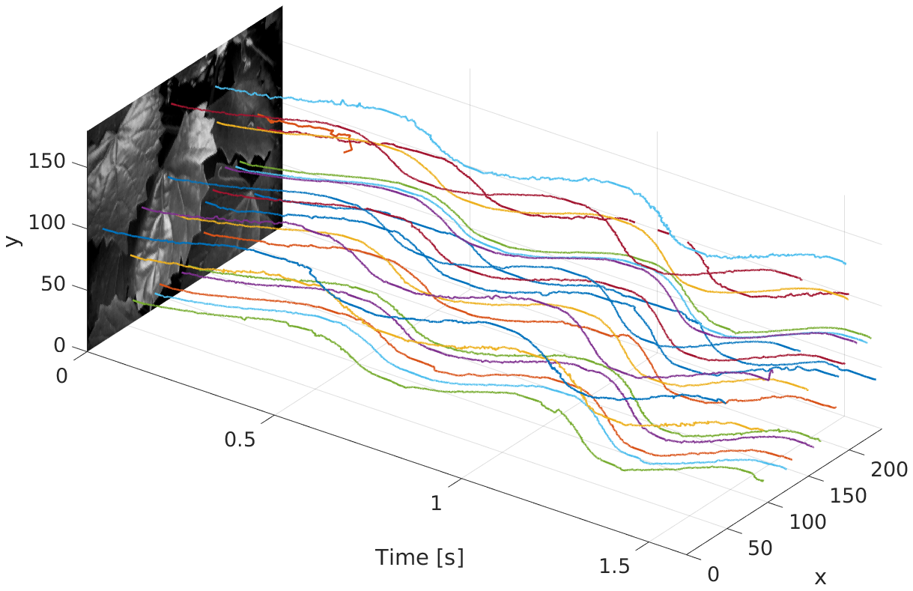
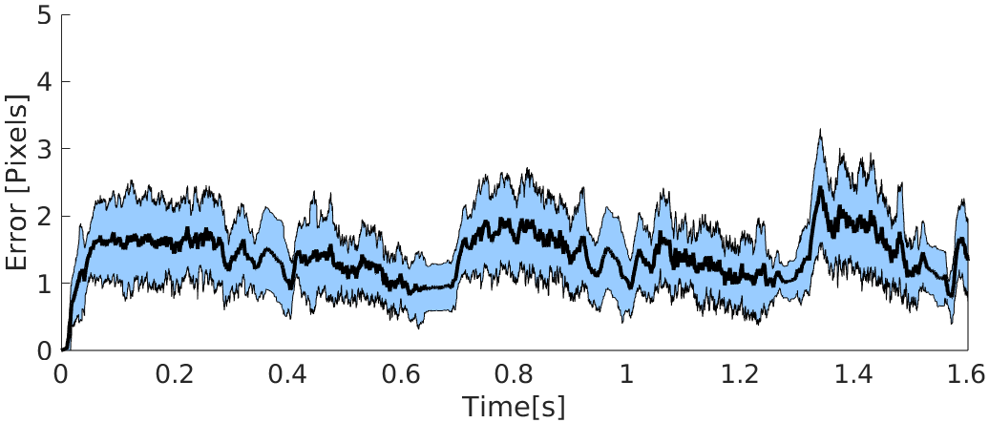
Results: Leaves
Natural scene
Oscillatory motion
20 features
Mean error: 1.48 pixels
Ground truth: image-based feature tracking

Slide 16
Discussion
Features can be tracked for a considerable amount of time:
  Much more than just between two frames (50+ frames/2+ sec)
  Extract new feature from the next frame
Event-based feature tracking is accurate (less than 2 pixels error)
  However: frame-based tracking is typically below 0.5 pixels
Initialization is based on frames that suffer from motion blur and limited dynamic range
  Extract features directly from the events, too

Slide 17
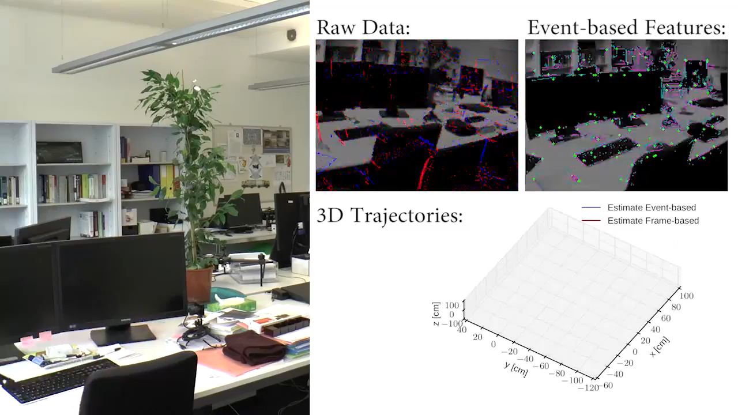
What is next?
[Submitted to IROS’16]

